Slide 1
Investigating the Tax Gap 2013-2026
William Kruczek

Slide 2
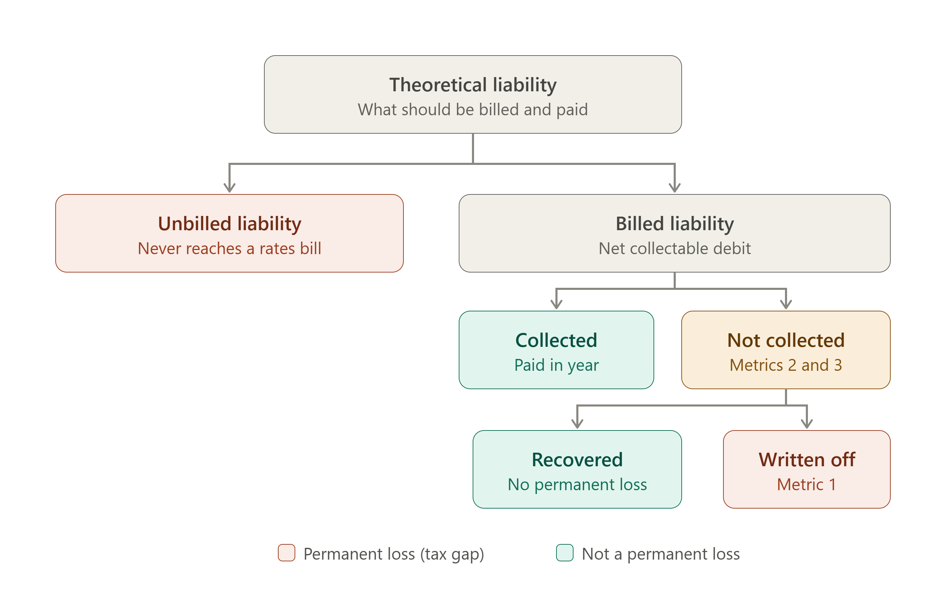
Understanding the Tax Gap
The scope of this commission will be focusing on the Not collected category
And investigating the breakdown of different Non Collection quantities via metrics 1 ,2, 3.
To better understand the dynamic billing authorities within this niche.

Slide 3
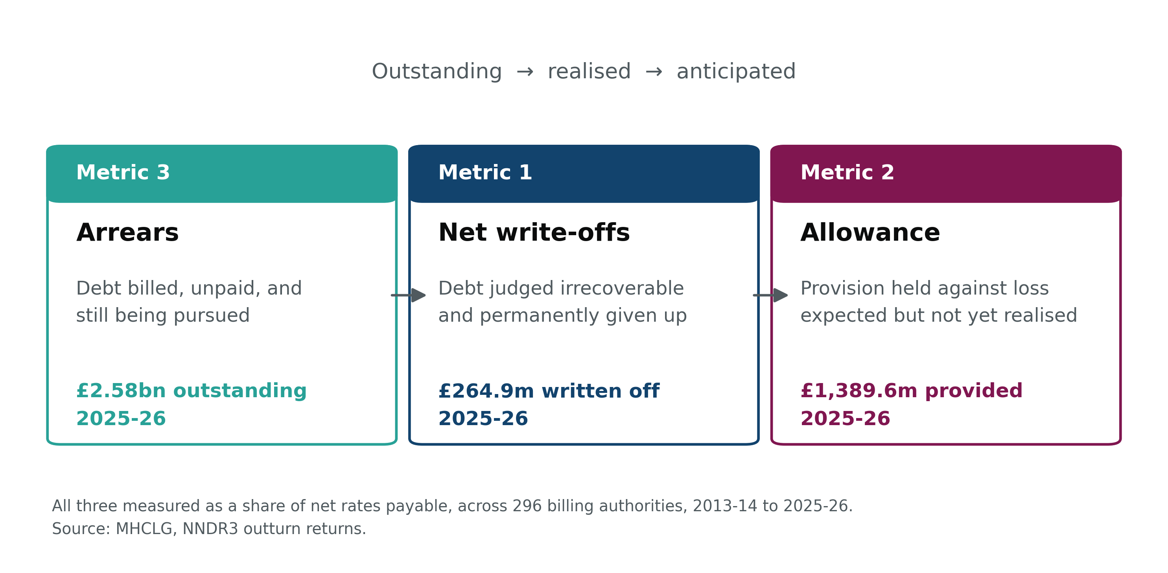
Understanding the Tax Gap

Slide 4
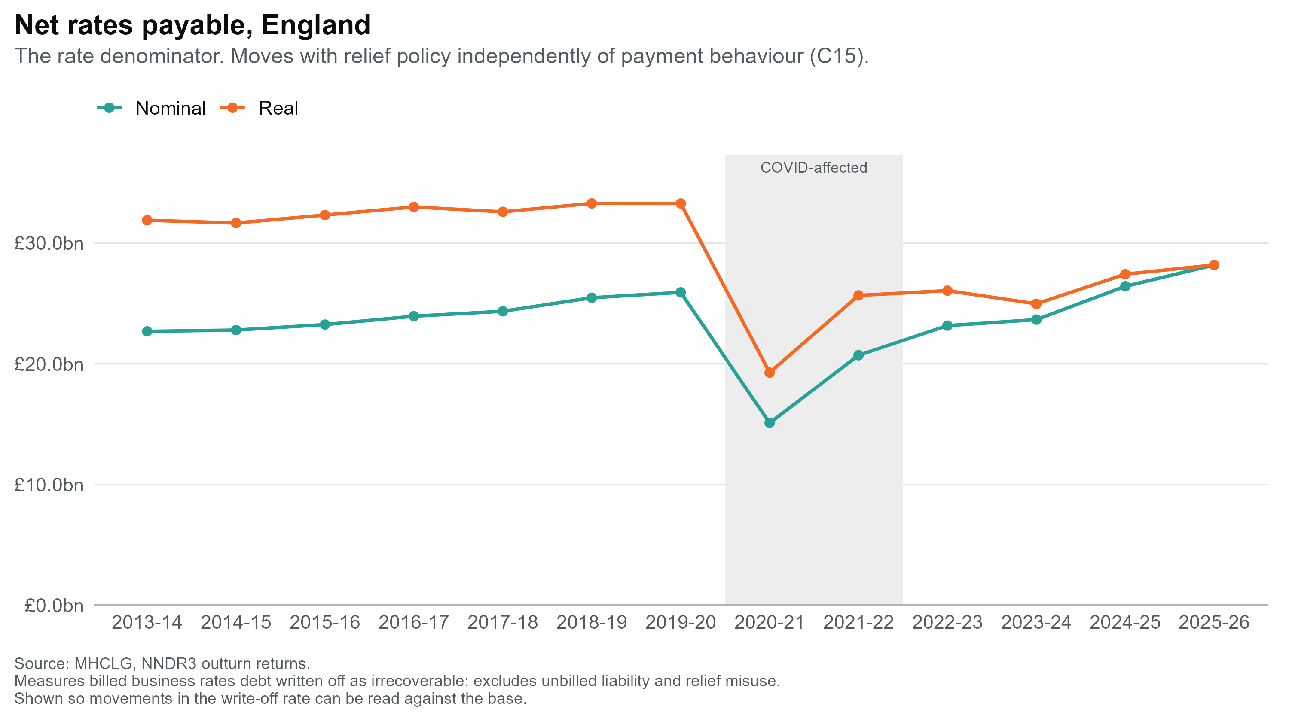
Billing Authorities Business Rates
A single-year pilot across 296 billing authorities
Net rates payable dropped from around £26bn to roughly £15bn in 2020-21 as retail, hospitality and leisure relief expanded, then recovered to £28.2bn by 2025-26. This is the denominator behind every rate chart in this pack; it moves with relief policy, independently of whether ratepayers are paying.

Slide 5
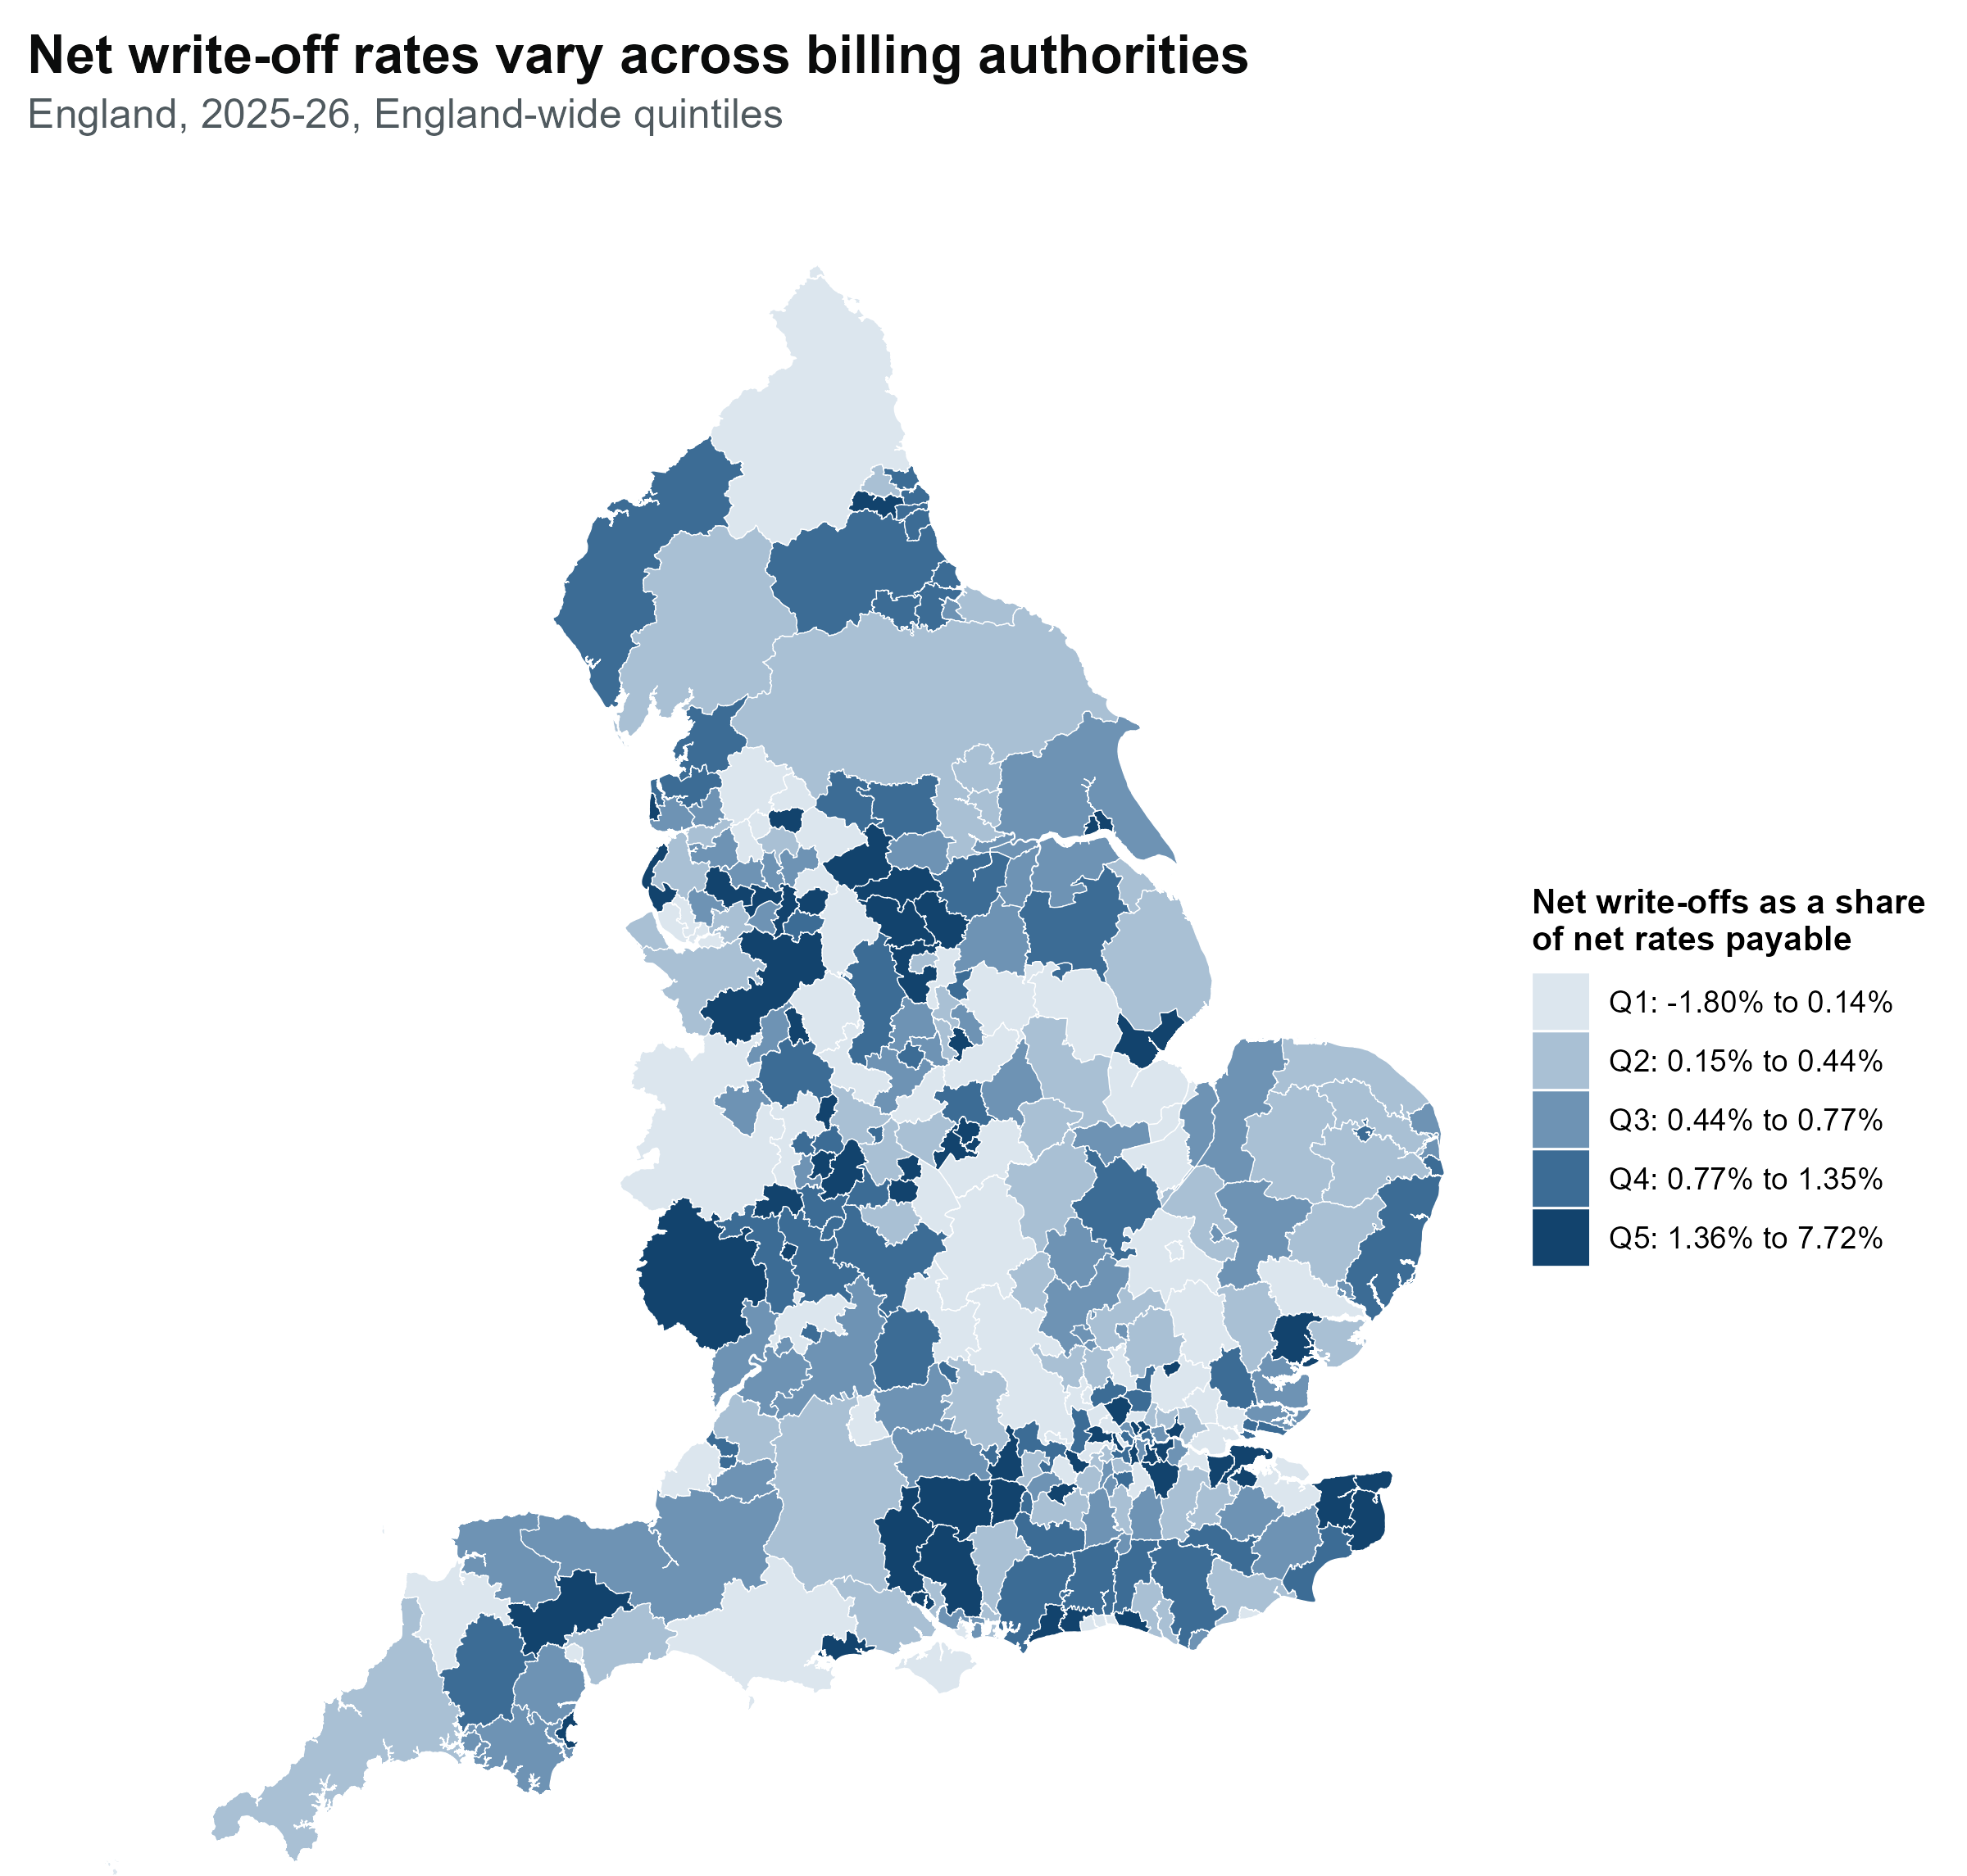

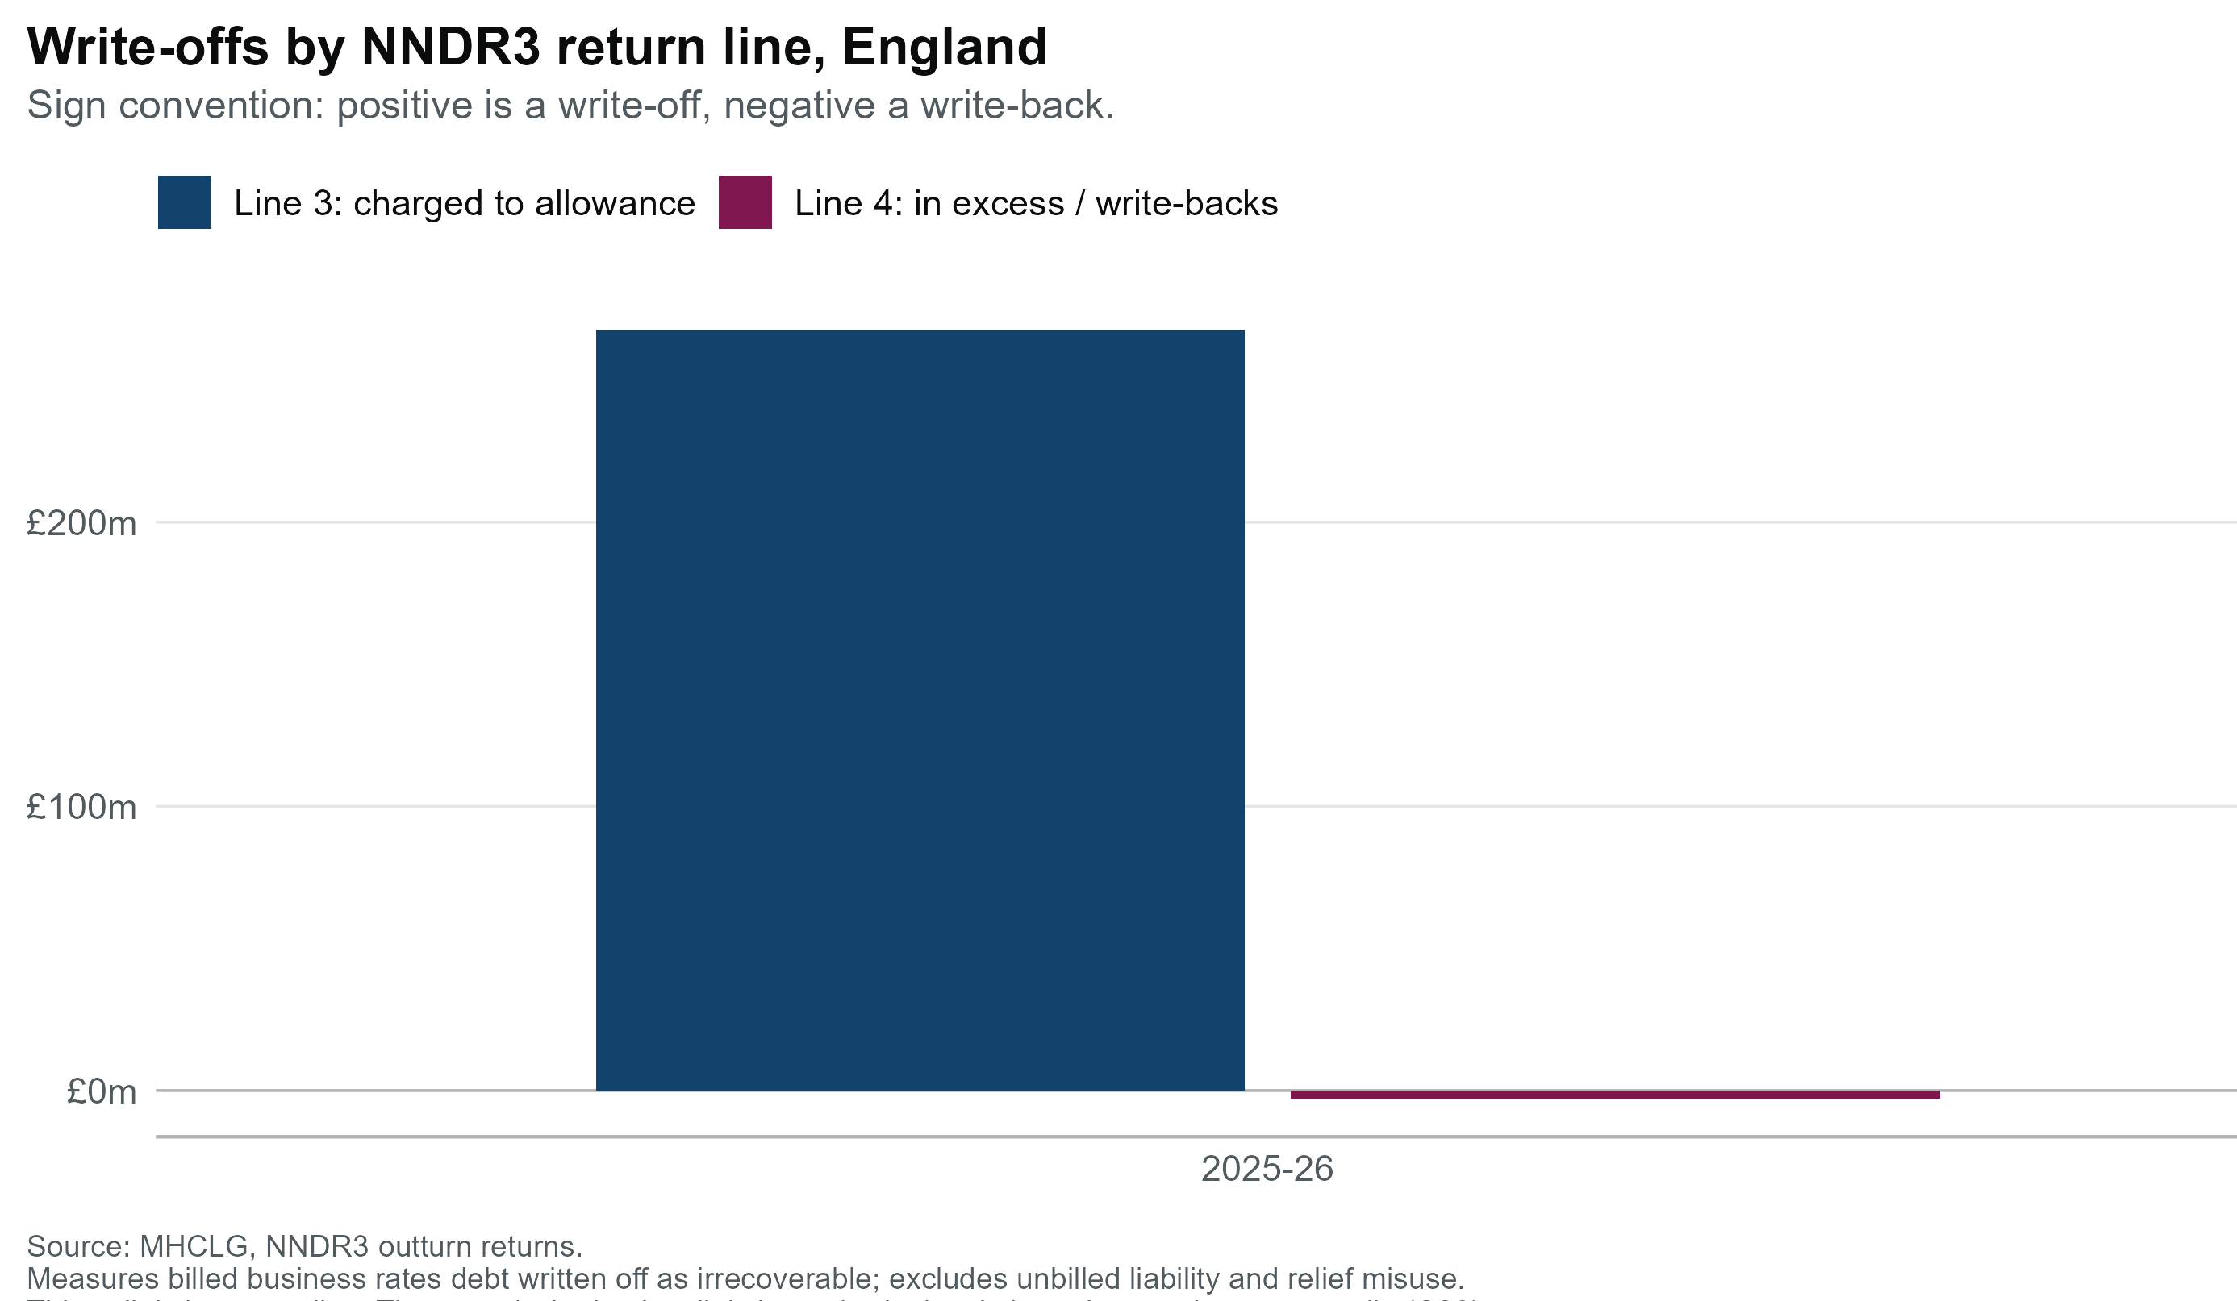
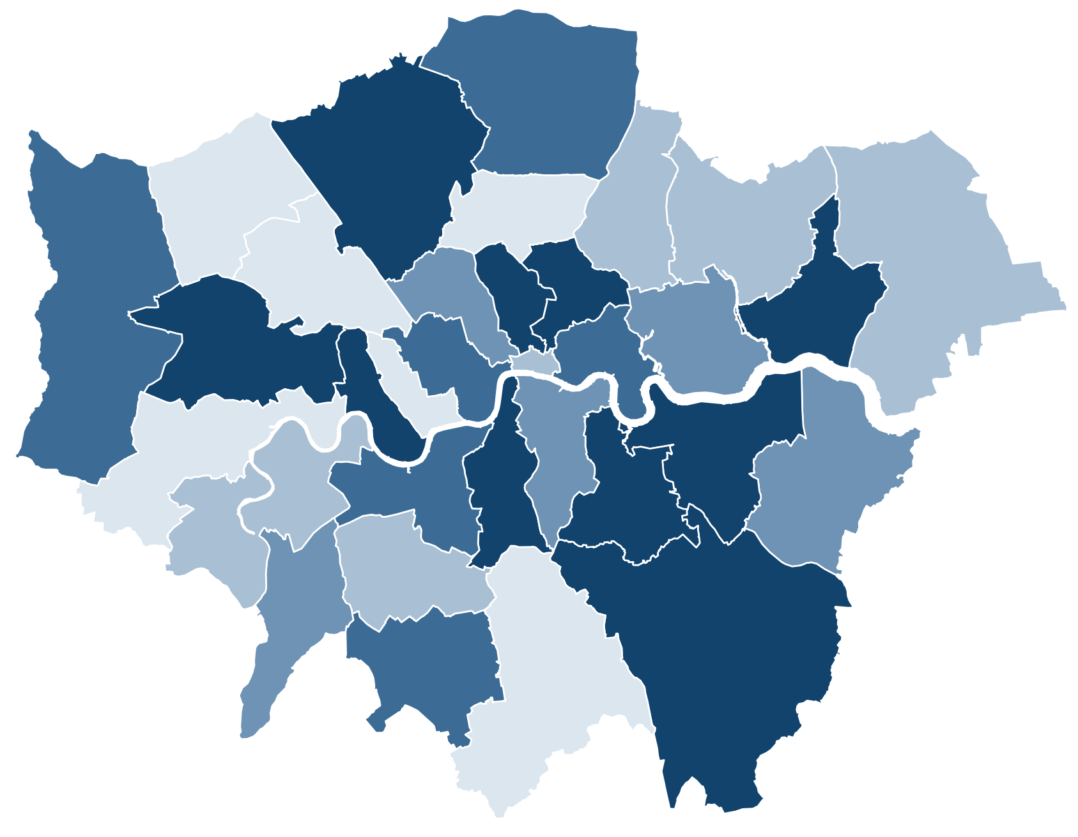
Net write-offs reached £264.9m in 2025-26, 0.94% of net rates payable
A single-year pilot across 296 billing authorities
Write-off rates vary across billing authorities; the pattern below is a first look and specific regional areas do not show any significant clustering.
Nearly all of the 2025-26 figure sits in charged to the allowance, £267.7m. Write-backs in excess of the allowance is a small net negative (−£2.8m)

Slide 6
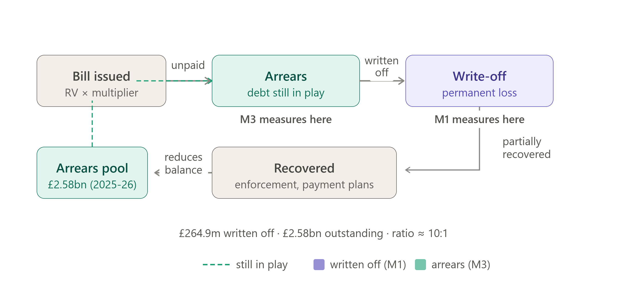
Before debt is written off, it accumulates as arrears
Before debt is written off, it accumulates as arrears. Arrears is where the tax gap begins

Slide 7
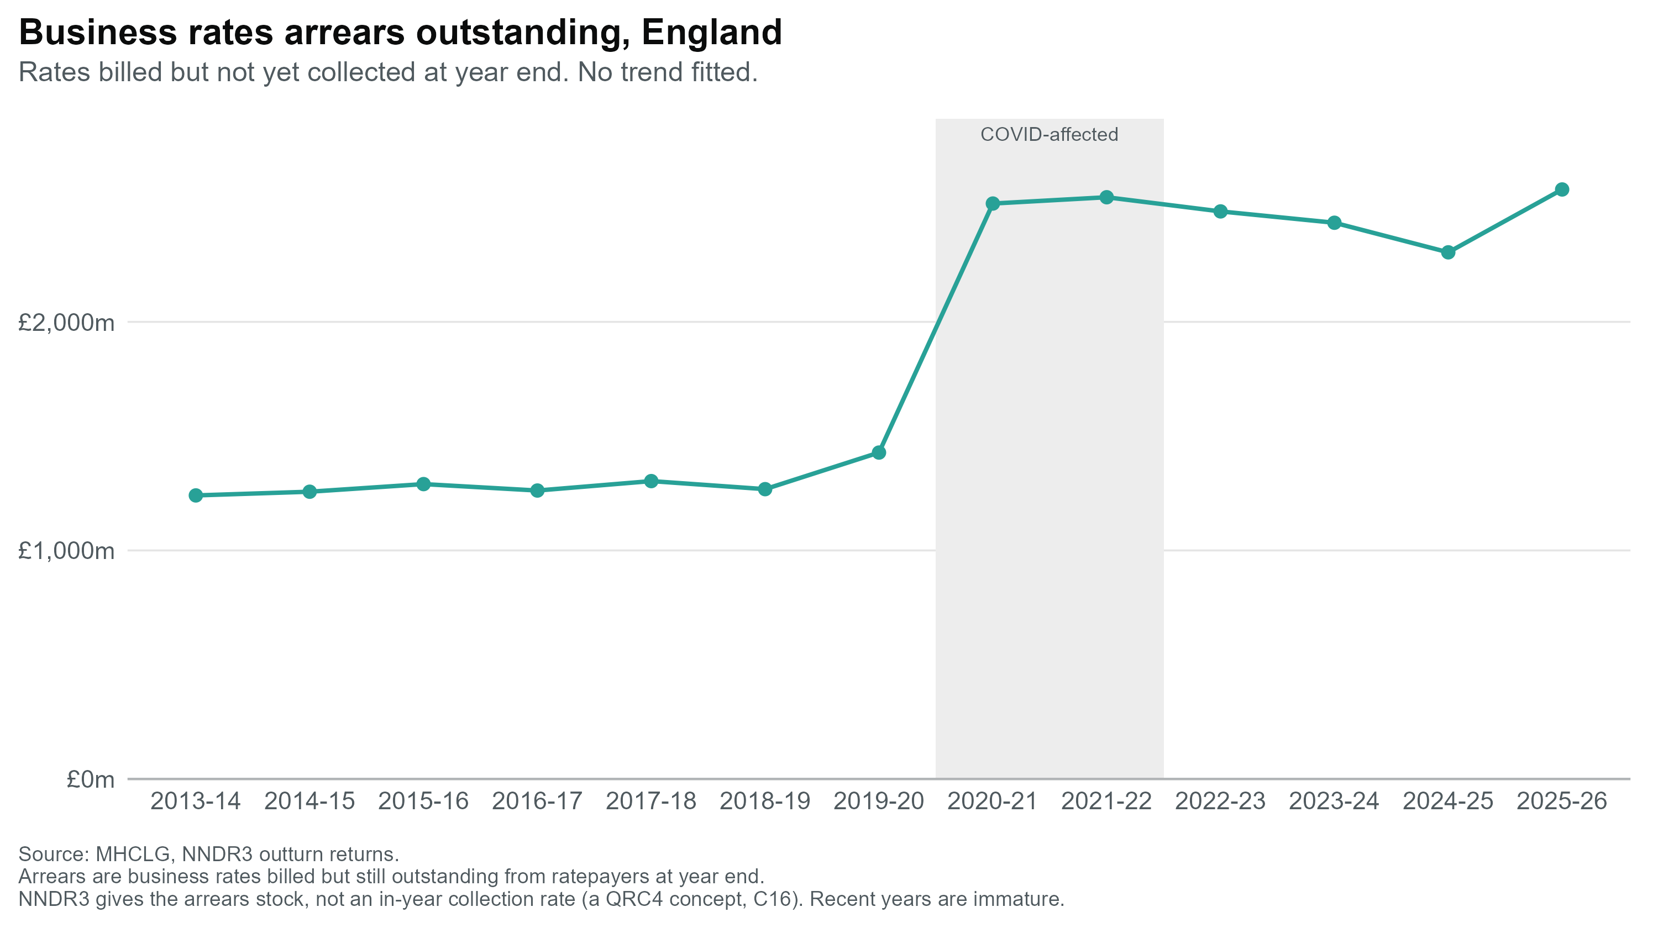
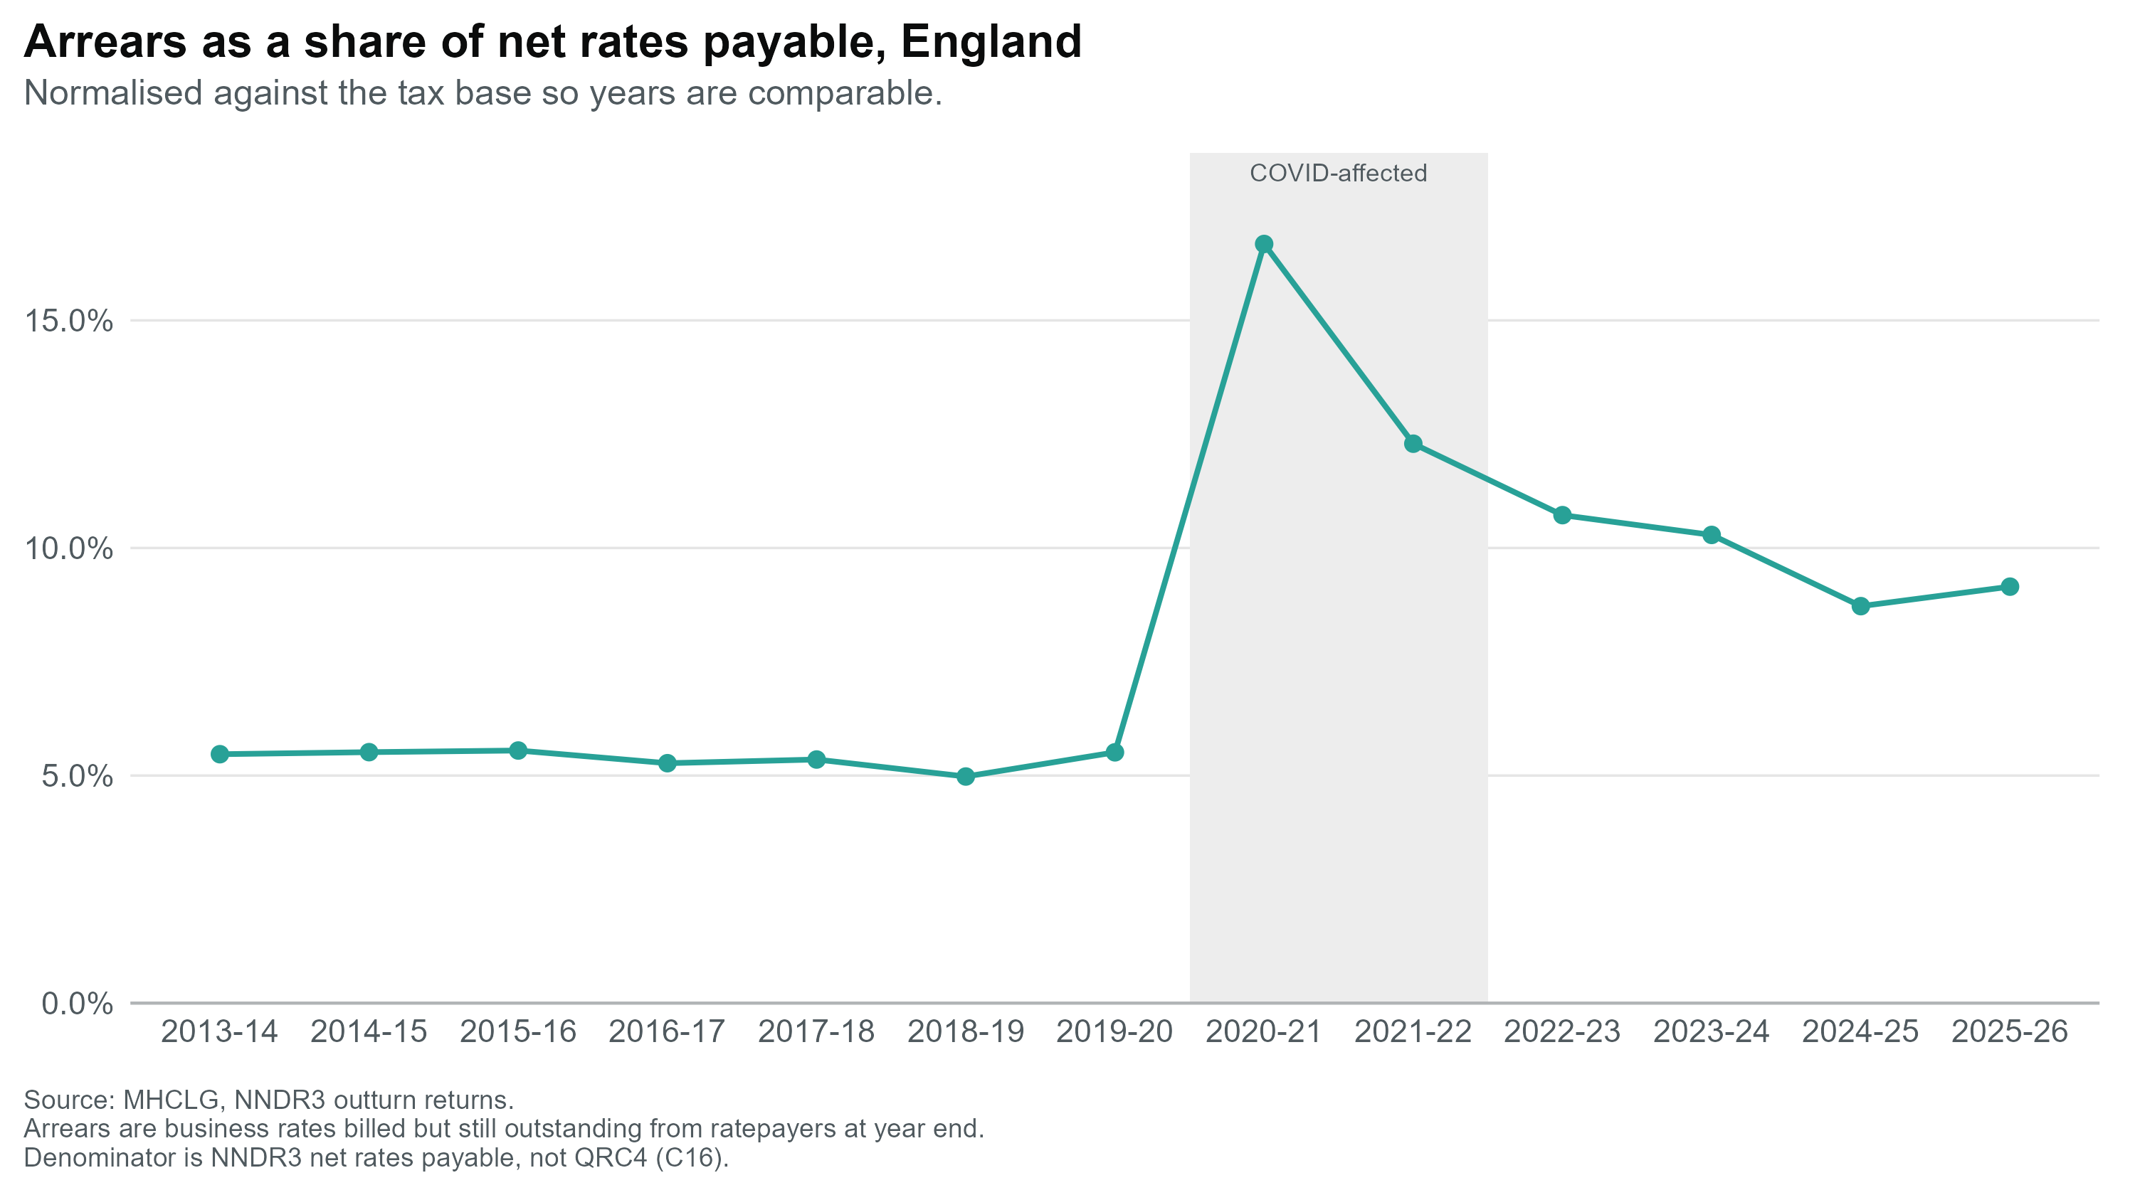
Arrears outstanding rose sharply during COVID and remain above pre-pandemic levels
The median LA approved 68% of requests for assessment, ranging from 26% to 96% across authorities
Arrears rose from around £1.3bn pre-COVID to a peak near £2.5bn in 2020-21, and stood at £2.58bn in 2025-26.
As a share of net rates payable, arrears rose from around 5% pre-COVID to 16.7% at the 2020-21 peak, and have eased to about 9.2%.

Slide 8
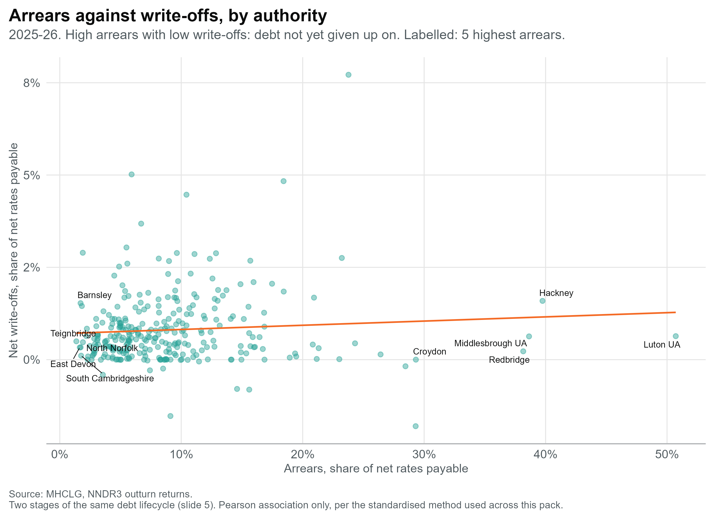
Arrears outstanding rose sharply during COVID and remain above pre-pandemic levels
The median LA approved 68% of requests for assessment, ranging from 26% to 96% across authorities
Arrears reached £2.58bn in 2025-26, up from ~£1.3bn pre-COVID
As a share of net rates payable: 5% → 16.7% peak (2020-21) → 9.2% now. Still roughly 2x the pre-pandemic level five years on

Slide 9
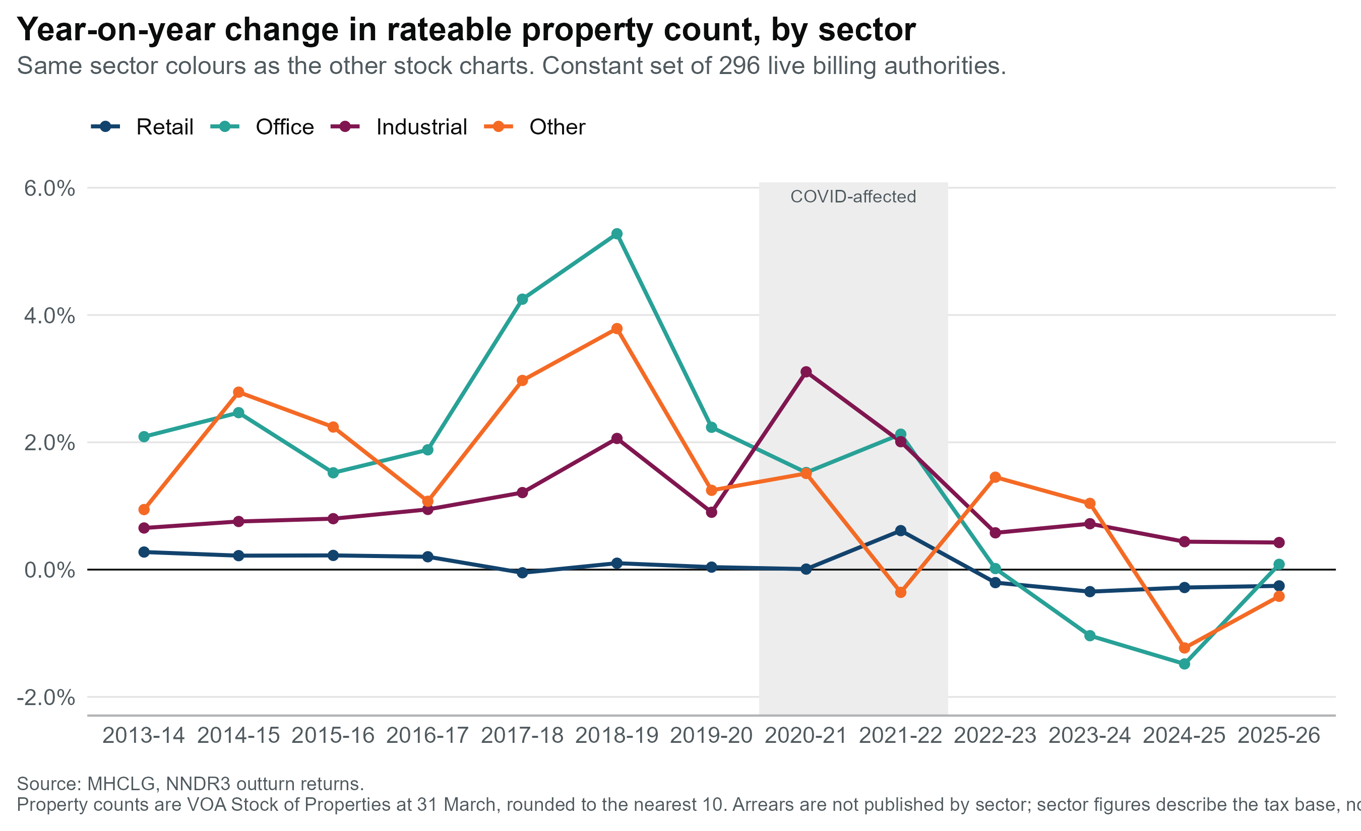
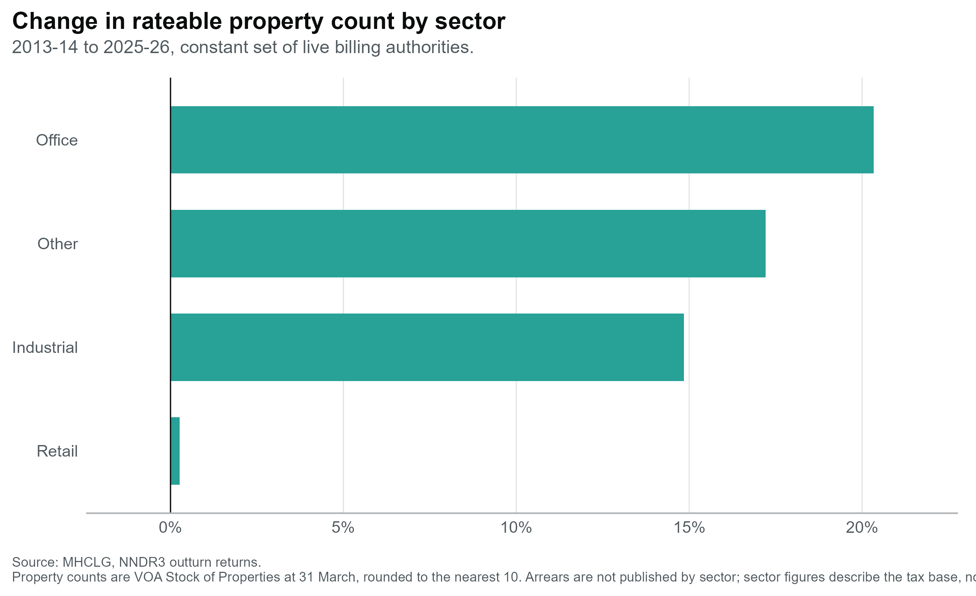
Further Breaking down Arrears
Below time series shows that generally property count rises YoY, till 18-19 where there is a systemic decrease following this peak. Retail is an outlier showing little deviation across the entire time sample.
Colour match bars to the line graph

Slide 10
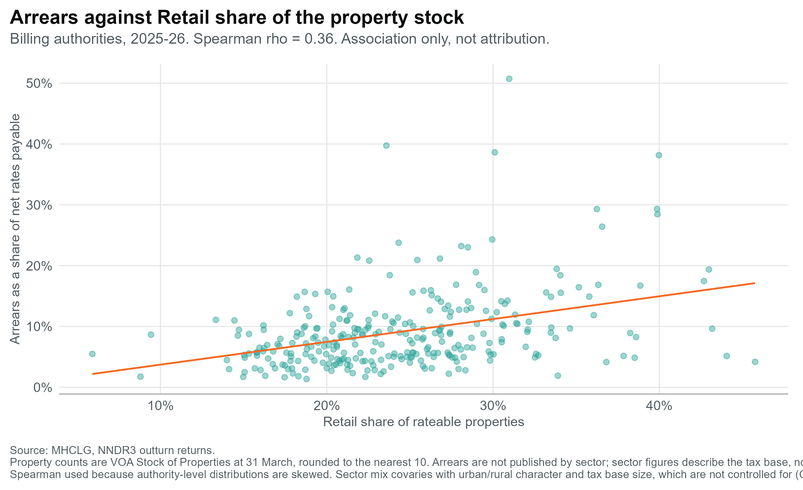
The relationship between Arrears and distinct sectors
Given that retail remains the most established and consistent property sector showing little variation in count over the time series, how does it pertain to the rise in arrears?
Retail share and arrears are positively associated, but weakly. ρ = 0.36 across 296 billing authorities in 2025-26. Authorities with a higher retail share of stock do tend to run higher arrears rates, so retail mix is one contributor among several, not the driver.
Retail isn't declining, it's static. Share fell 27%→24% by dilution, with all the other sectors growing by more than 15%

Slide 11
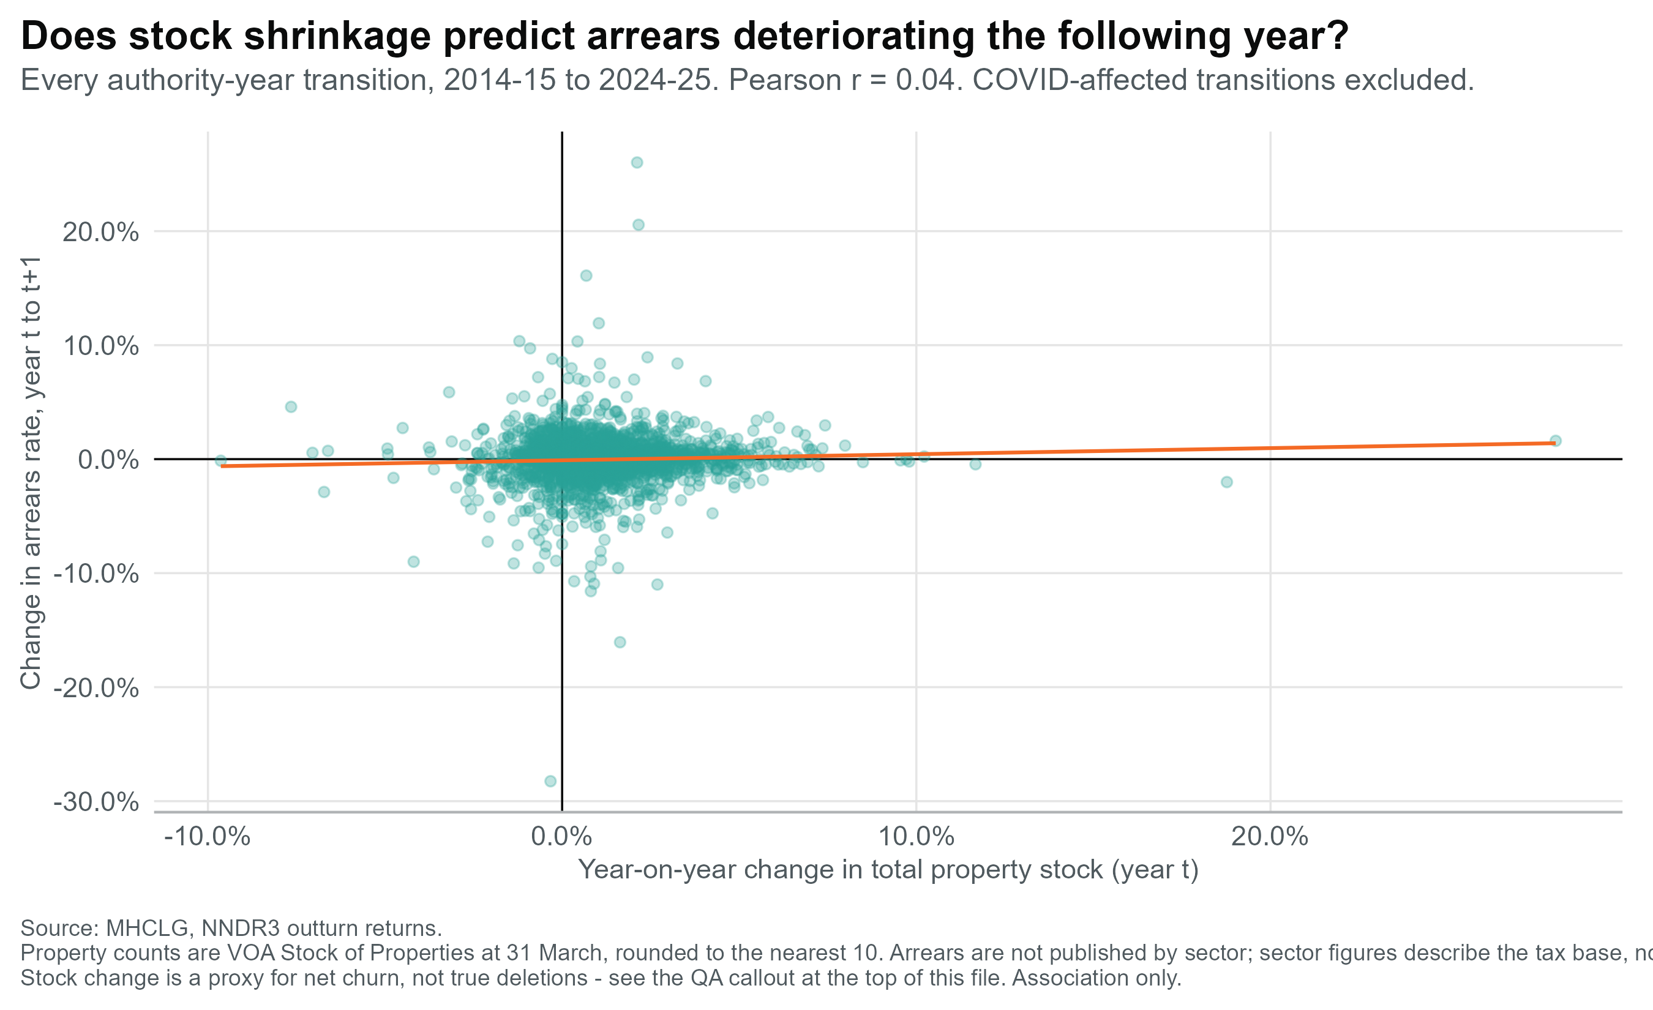
Has the sector-arrears relationship held over time?
Rather than focusing on a single year time series, tracking the YoY change in arrears and property stock
Tells us SOP cannot reliably predict a billing authority's propensity to accrue arrears.
Once fixed authority characteristics are differenced out, movement in the tax base does not move arrears.
Then why still use SOP with single years analysis?
Because the two answer different questions, and only one of them failed.
The cross-section (ρ = 0.36) is a valid statement about which authorities carry more arrears. Retail-heavy authorities genuinely do run higher rates that structural difference is real and useful for targeting.
What differencing kills is the causal reading. Retail share moves barely ±1% a year against arrears swings of ±30%, so there is too little movement to detect an effect either way.
So SOP describes, it doesn't predict. It marks out which authorities sit in the higher-risk group; it cannot explain why arrears rose. That is precisely why the next section stops asking which sectors and starts asking which authorities.
Remove t comment in caption, colour code matching bar chart theme
*SOP = Stock of Properties

Slide 12
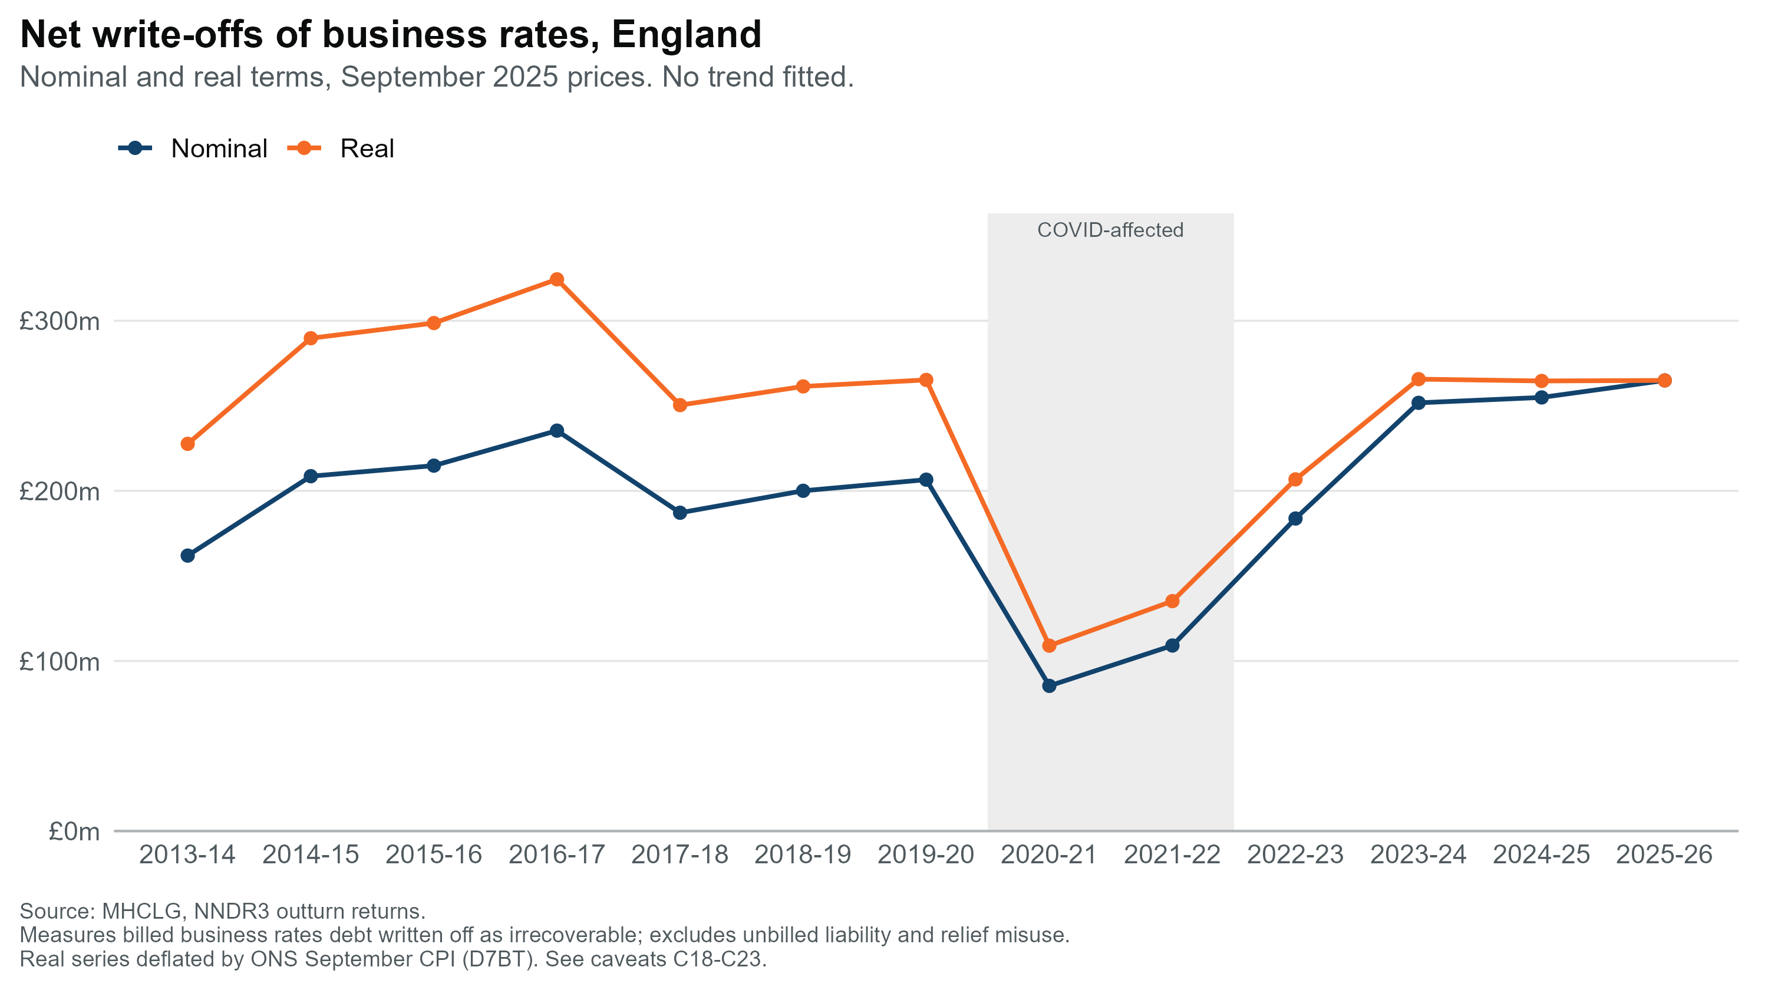
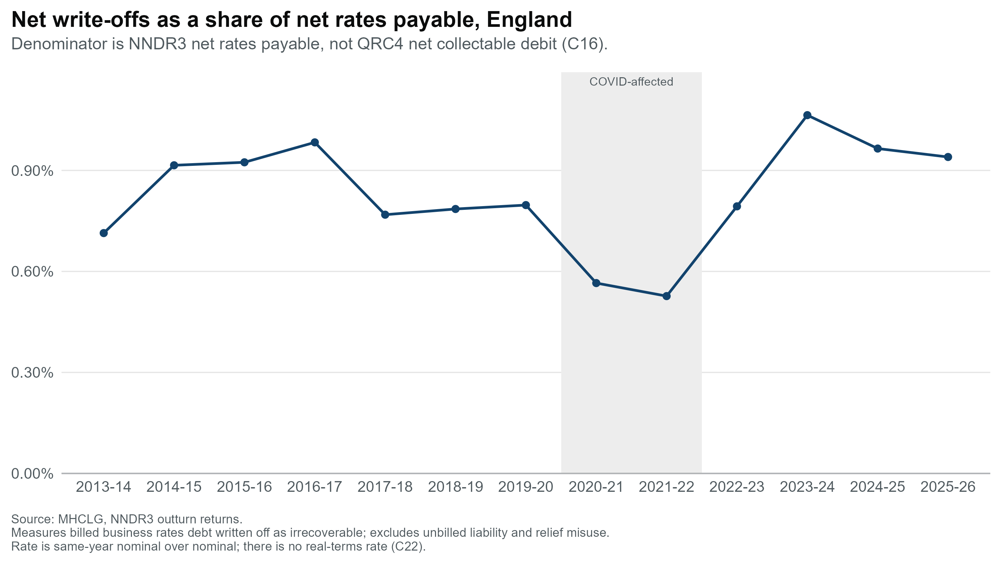
Net write-offs have grown across the series, but the shape reflects COVID and data immaturity more than a clean trend
Write-offs ran at £161.9m in 2013-14, fell to £85.4m at the COVID trough (2020-21), and have since risen to £264.9m. Real and nominal terms converge at the September 2025 price basis.
The rate has moved between 0.53% and 1.06% of net rates payable. Denominator is NNDR3 net rates payable, not QRC4 net collectable debit

Slide 13
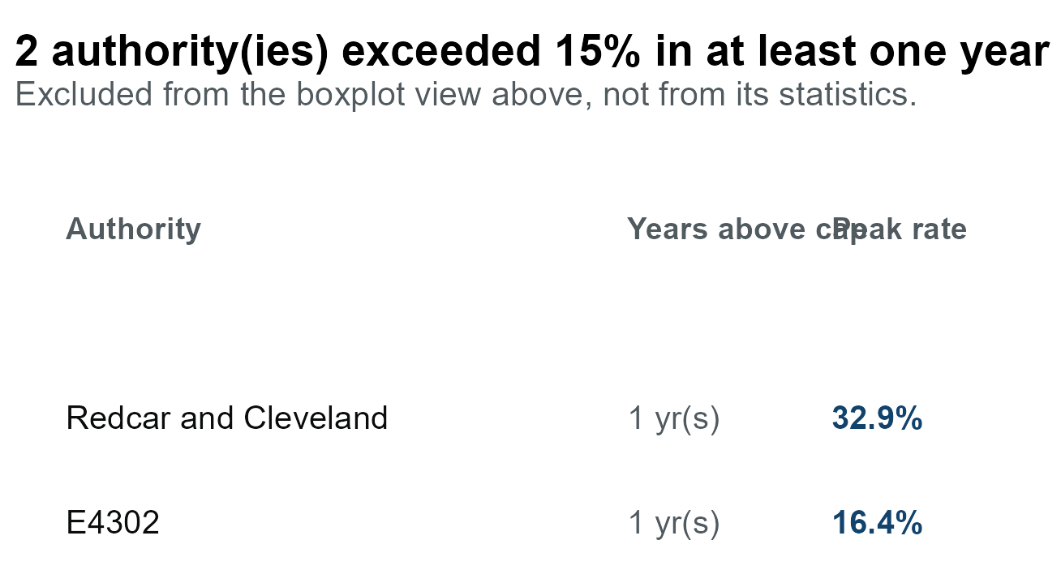
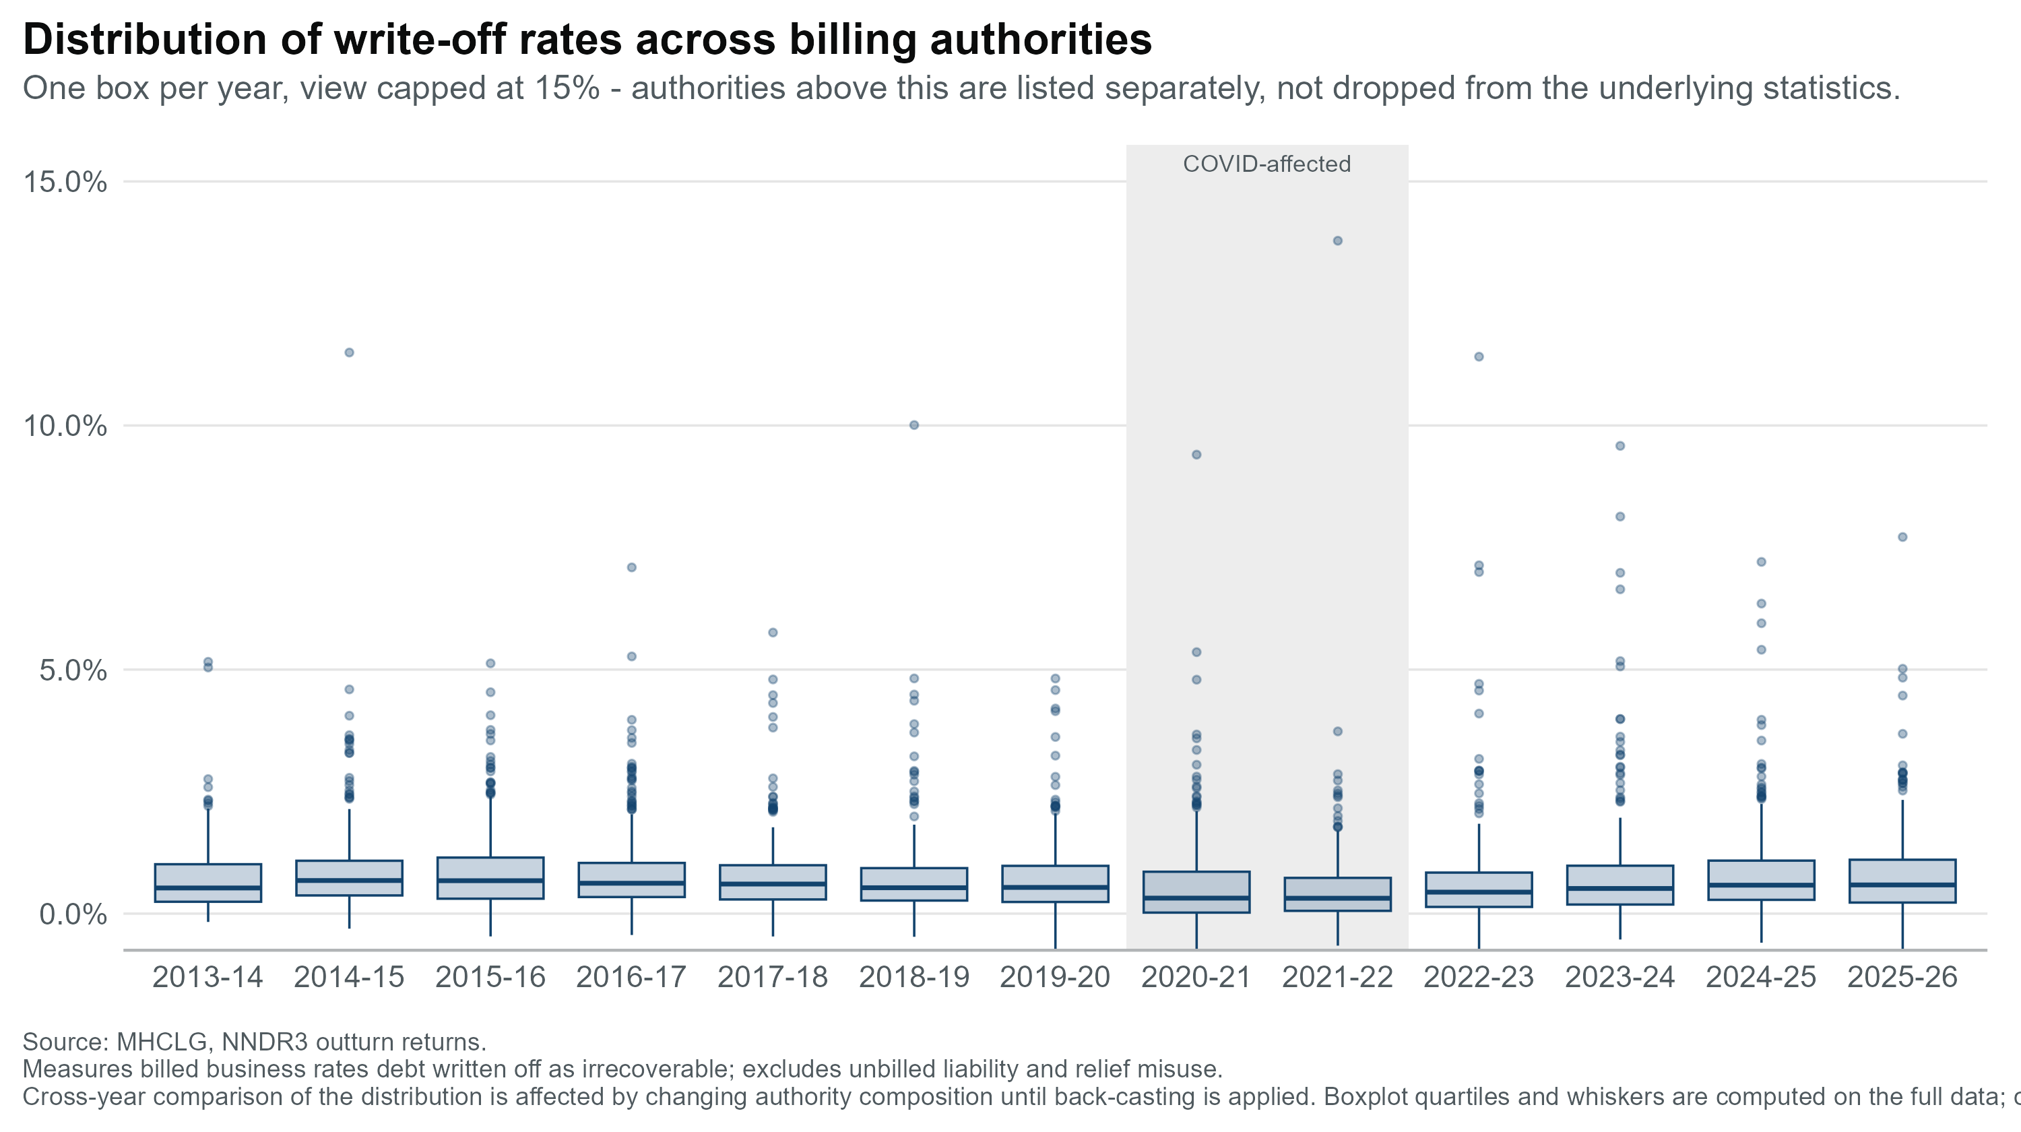
How are these net write-offs distributed between LAs?
Liverpool
Why Redcar & Liverpool
Both are post-industrial with concentrated rateable value in declining sectors. Redcar's 32.9% was a single-year spike (2/13 years top quartile), whereas Liverpool is 13/13 on allowance and arrears but only 6/13 on write-offs.
Different patterns, not the same story, worth not conflating them.
[insert analysis – do any kind of geographical research to see if there is any relevance between redcar and Cleavland with liverpool]

Slide 14
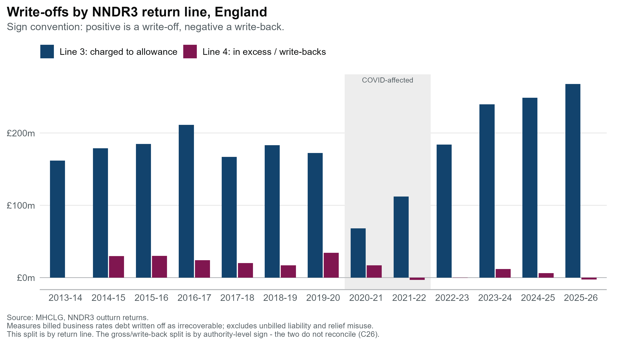
Actually charged-to-allowance vs write-backs
Charged to Allowance
£267.7m in 2025-26, a series high, 3.9x the 2020-21 trough (£68.2m). Losses are increasingly ones the provision already anticipated.
Write backs
Write-backs have collapsed from £24.6m/year (2014-19) to £2.4m since 2021-22, at or below zero in 3 of the last 5 years. Surprises to the fund have largely disappeared.
Charged to allowance draws down the provision; Line 4 is what it missed. As Line 4 fades, write-offs are increasingly ones already provided for, the same story as the provision slide.

Slide 15
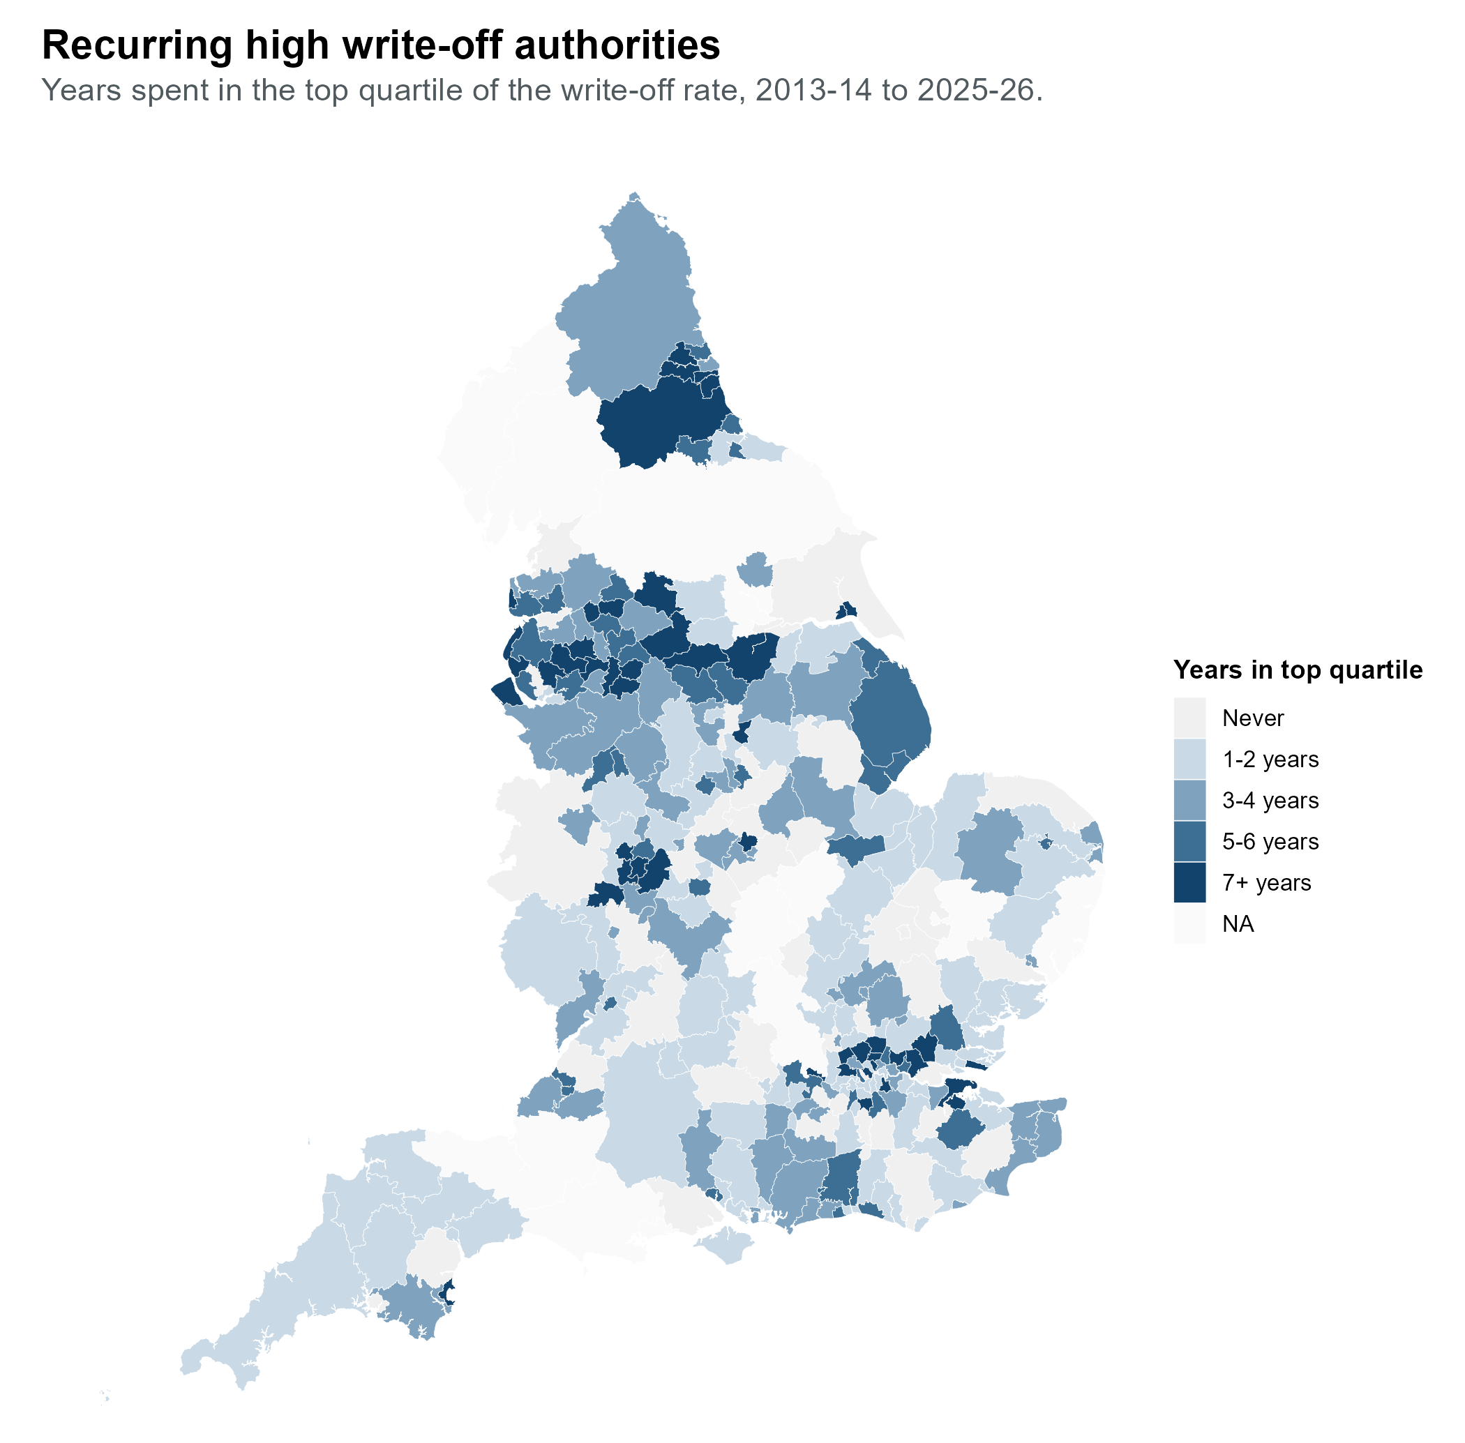
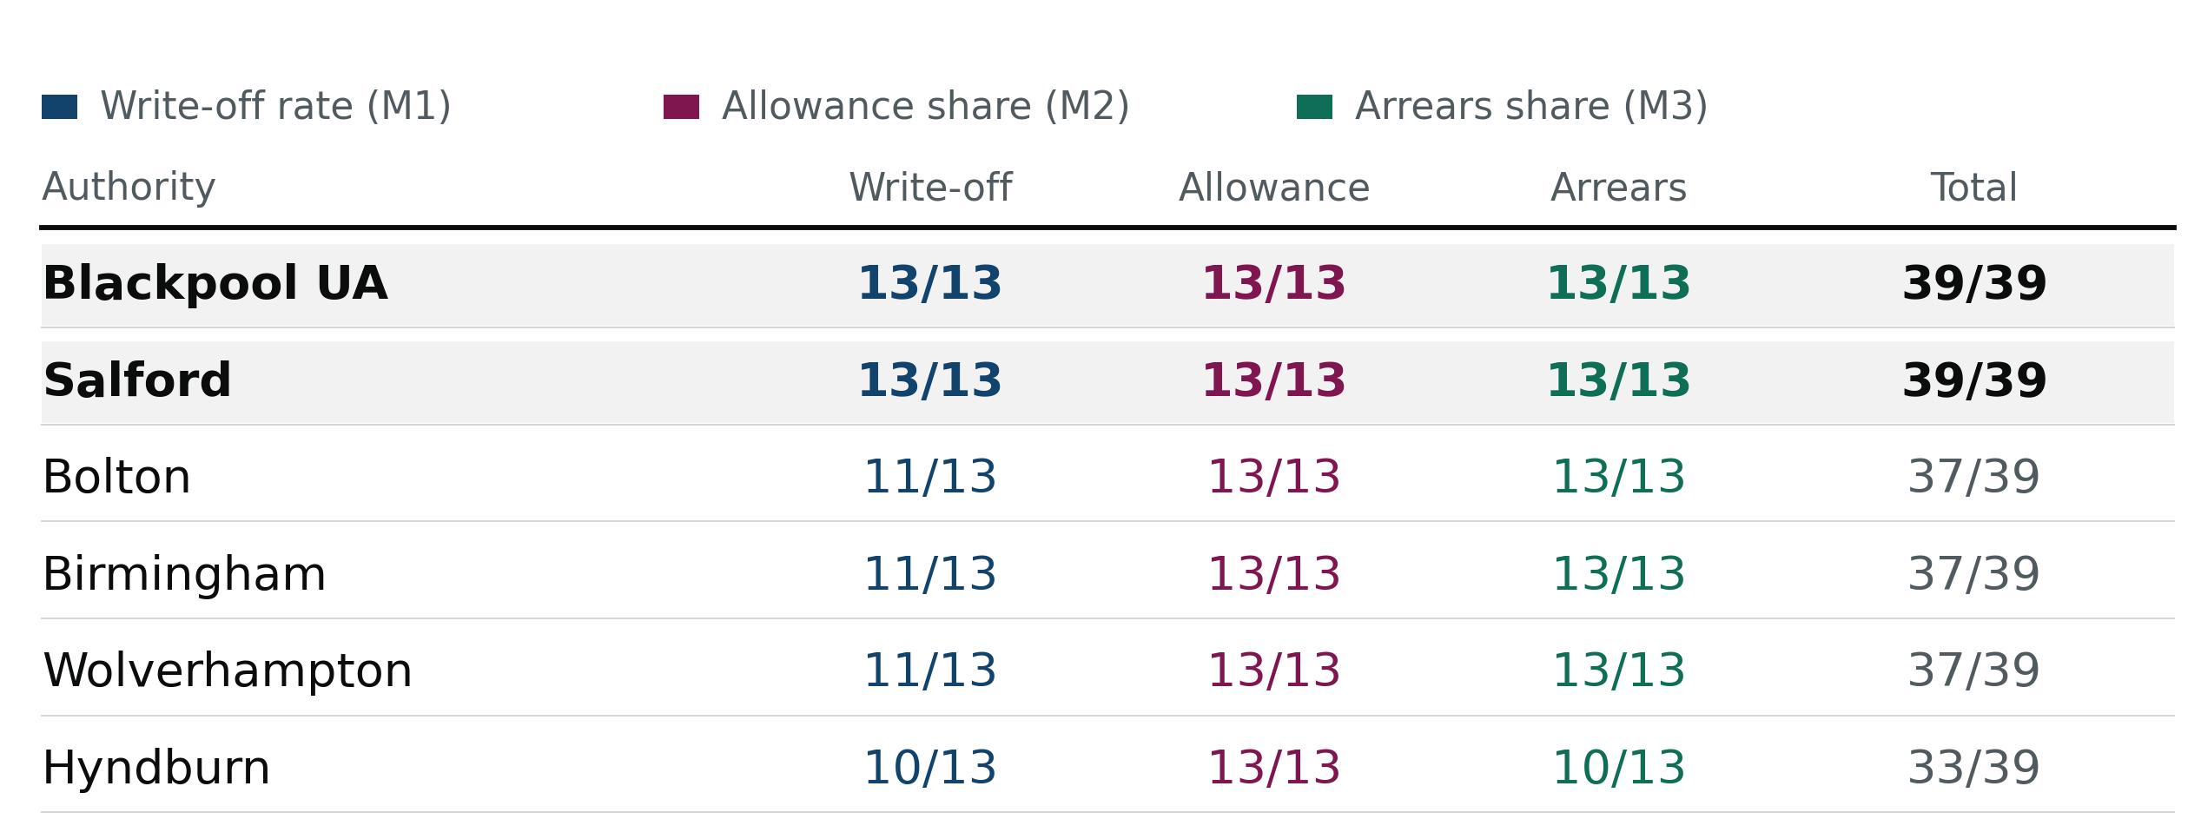
Amongst the different metrics are there recurring outliers?
Investigating which authorities write off the most
* How many years of the 13 year time series LAs where in the upper quartiles, i.e 13/13 would mean that an LA was in the upper quartile of a given metric for 13 years
Add London aswell

Slide 16
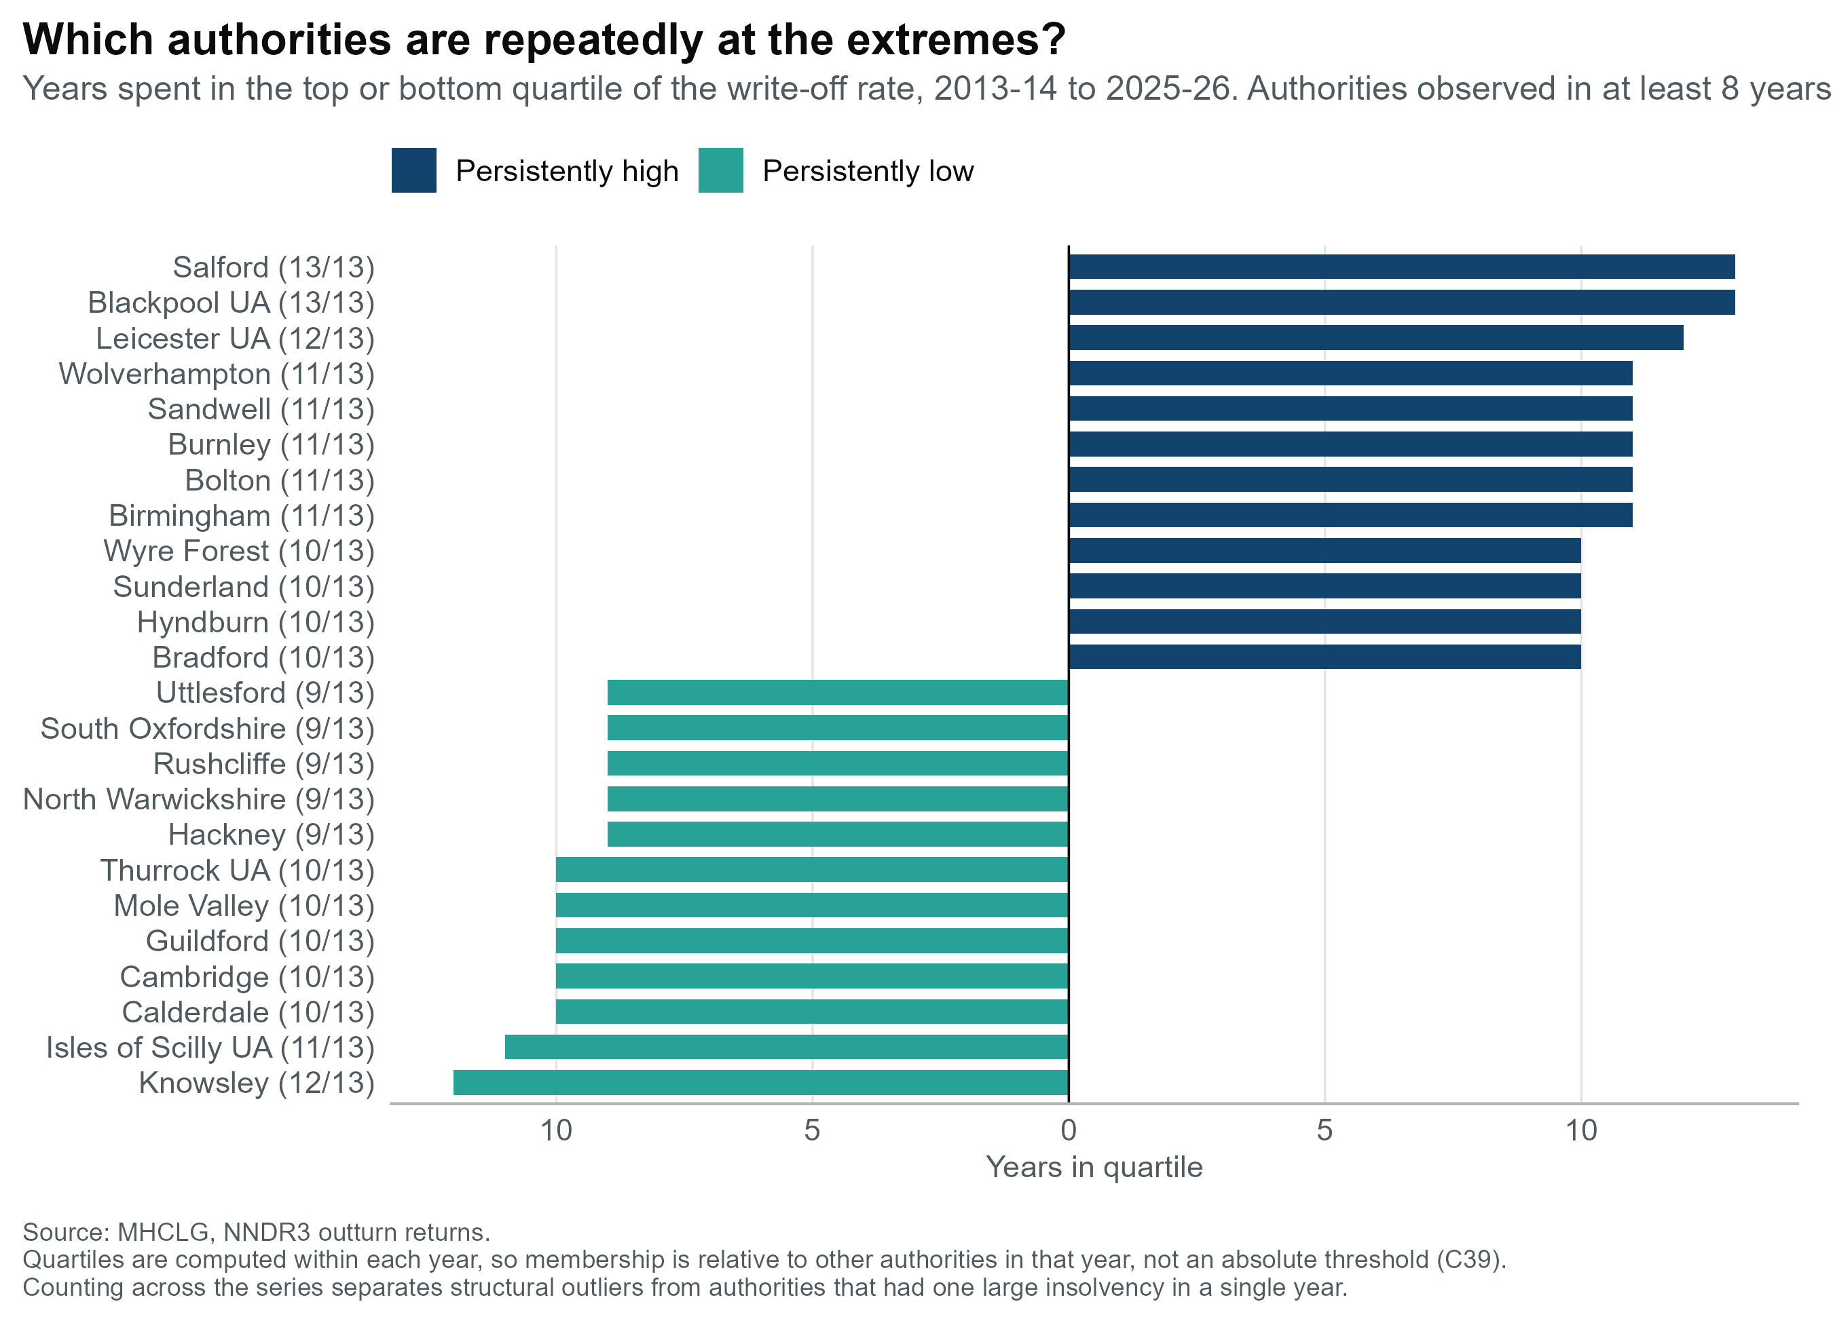
Amongst the different metrics are there recurring outliers?
Two distinct clusters, and they behave differently:
Post-industrial North and Midlands: Greater Manchester (Salford, Bolton, Manchester, Tameside, Wigan, Stockport), Lancashire (Blackpool, Burnley, Hyndburn, Preston, Rossendale), West Midlands (Birmingham, Wolverhampton, Sandwell, Dudley, Walsall), Merseyside (Liverpool, St Helens, Wirral). High on all three metrics including write-offs, the loss is realised.
Outer London: Islington, Lewisham, Barnet, Ealing, Haringey, Harrow, Enfield, Redbridge, Croydon, Waltham Forest, Barking and Dagenham. High allowance and high arrears, but markedly lower write-offs. Debt is held and provisioned against, not given up on.
That contrast is the finding: same apparent pressure, opposite treatment. Whether London is exercising better collection discipline isn't answerable from NNDR3 alone
*That contrast is the finding: same apparent pressure, opposite treatment. Whether London is exercising better collection discipline or simply deferring recognition isn't answerable from NNDR3 alone — but it's a sharp question for the commission.

Slide 17
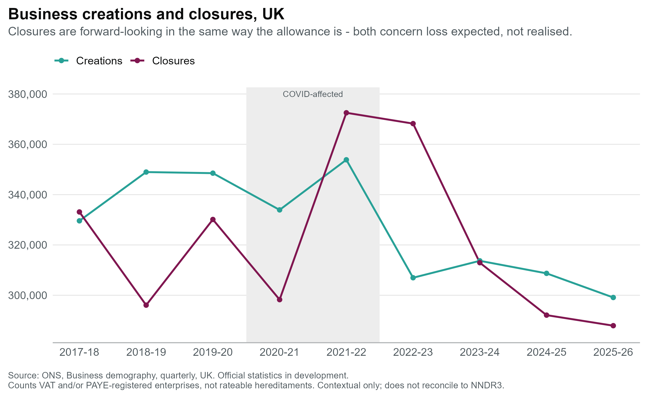
Write-offs bottomed out exactly as closure peaked - demography
The inversion. Closures hit a series high of 372,525 in 2021-22. Write-offs hit a series low of £85.4m in 2020-21
Why. Insolvency moratoria and forbearance suppressed write-offs precisely while failure peaked. The debt didn't disappear; recognition was deferred.
Since then. Closures have fallen every year to 287,910 in 2025-26, down 23% from peak. Write-offs have climbed to £264.9m. The loss is surfacing years after the failures that caused it.
Caveat: counts VAT/PAYE enterprises UK-wide, not hereditaments by authority. Explains the shape of the series; doesn't evidence causation.

Slide 18
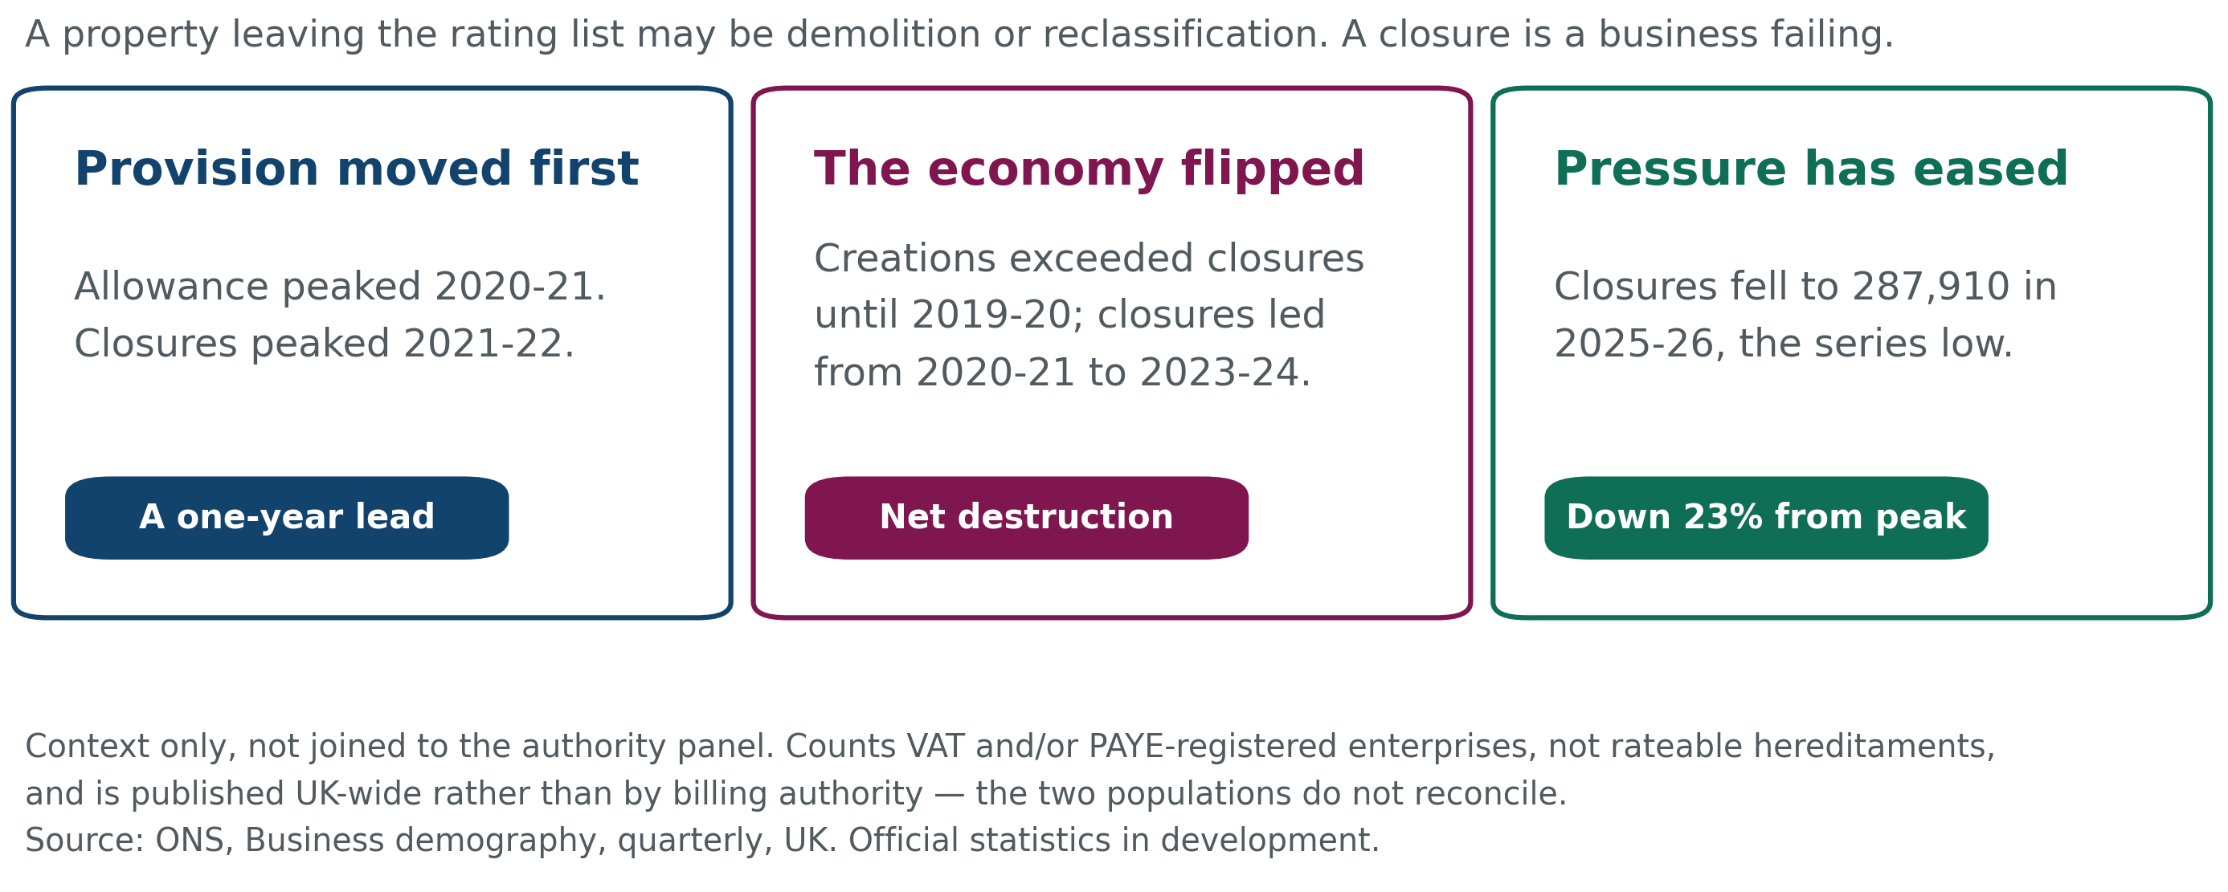
Business closures are the mechanism behind a write-off

Slide 19
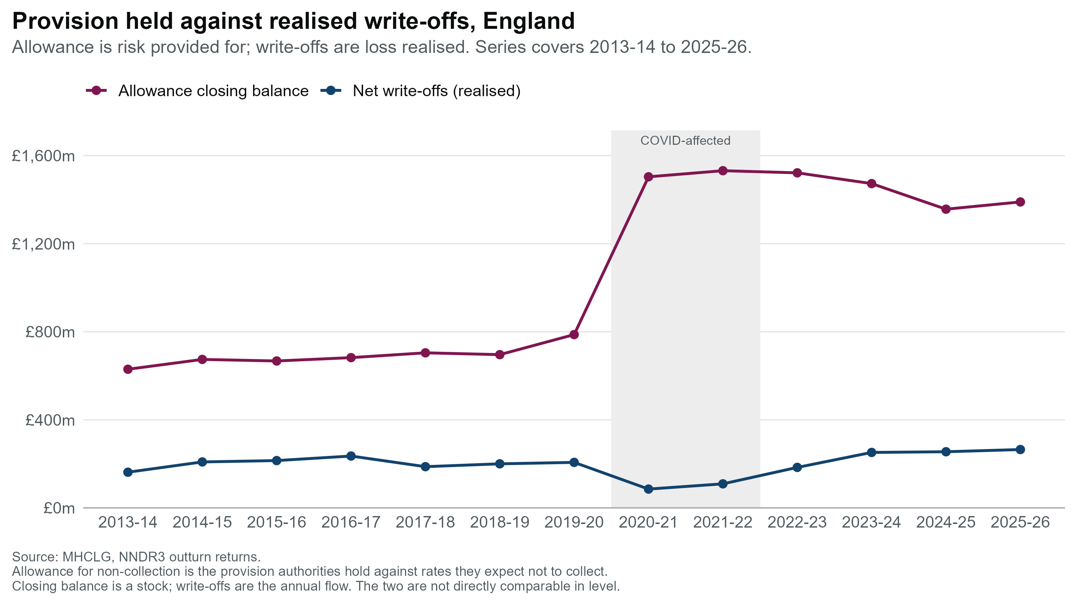
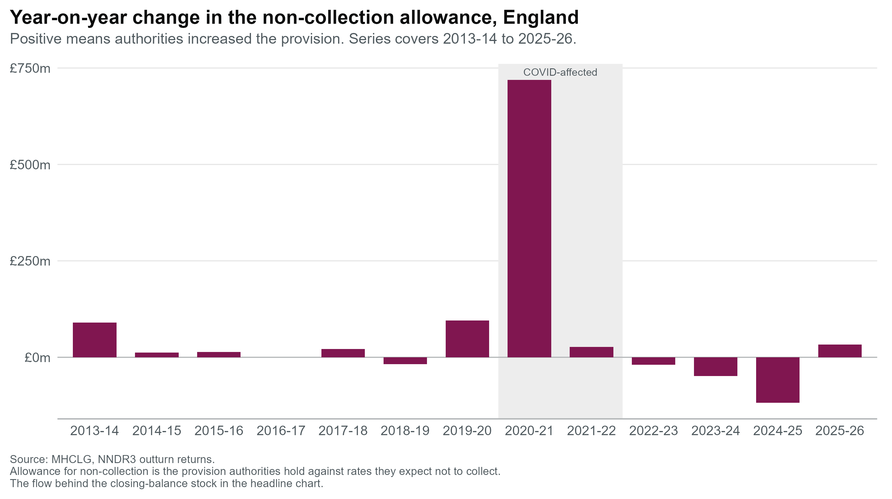
The non-collection allowance rose sharply as a share of the tax base through COVID and has only partly unwound
The allowance is a forward-looking measure of anticipated loss, not a record of loss already realised.
Allowance share of net rates payable climbed from around 2.7% in 2018-19 to a peak near 9.8% in 2020-21, and has eased to roughly 4.9% by 2025-26.
The year-on-year change shows the scale of the 2020-21 movement: authorities added over £700m to the provision in that single year, the largest single-year change in the series.

Slide 20

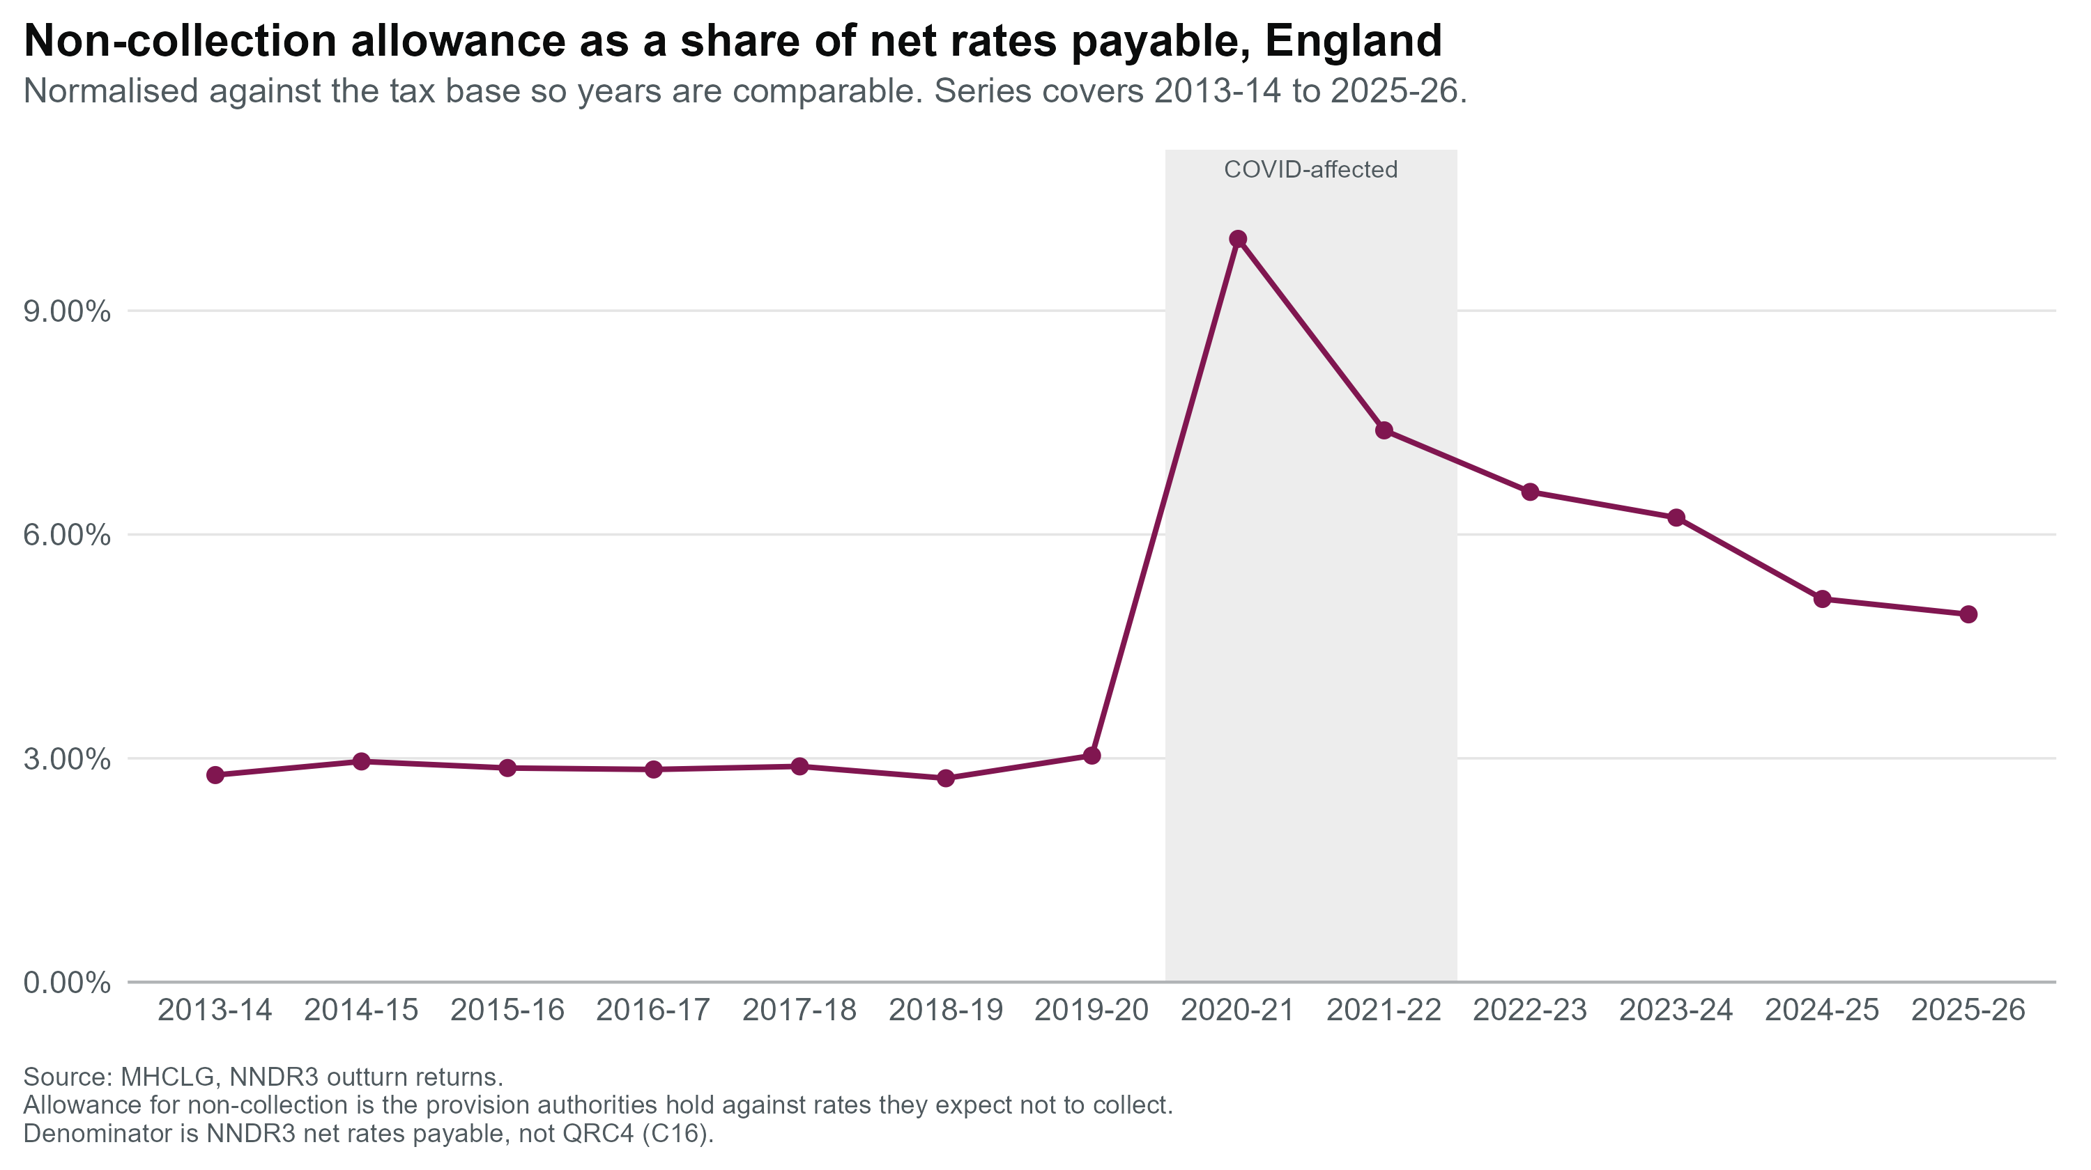

Authorities are holding provision several times larger than what is being written off annually
The gap between provision and realised loss is the forward-looking risk signal this metric was built to surface. Whether the current gap is expected for a stock-versus-flow comparison
Provision held is 5.25x annual write-offs in 2025-26 (£1,389.6m against £264.9m) well down from the pandemic peak, but still 52% above the pre-COVID average of 3.45x (2013-14 to 2019-20).
The 2020-21 spike was mechanical, not behavioural. The largest single-year increase on record, driving the ratio to 17.6x.
The ratio has fallen every year since 2020-21 17.6x → 14.0x → 8.3x → 5.9x → 5.3x → 5.25x.
Potentially reflecting a genuinely elevated risk view or a write-off cycle still maturing within the system

Slide 21
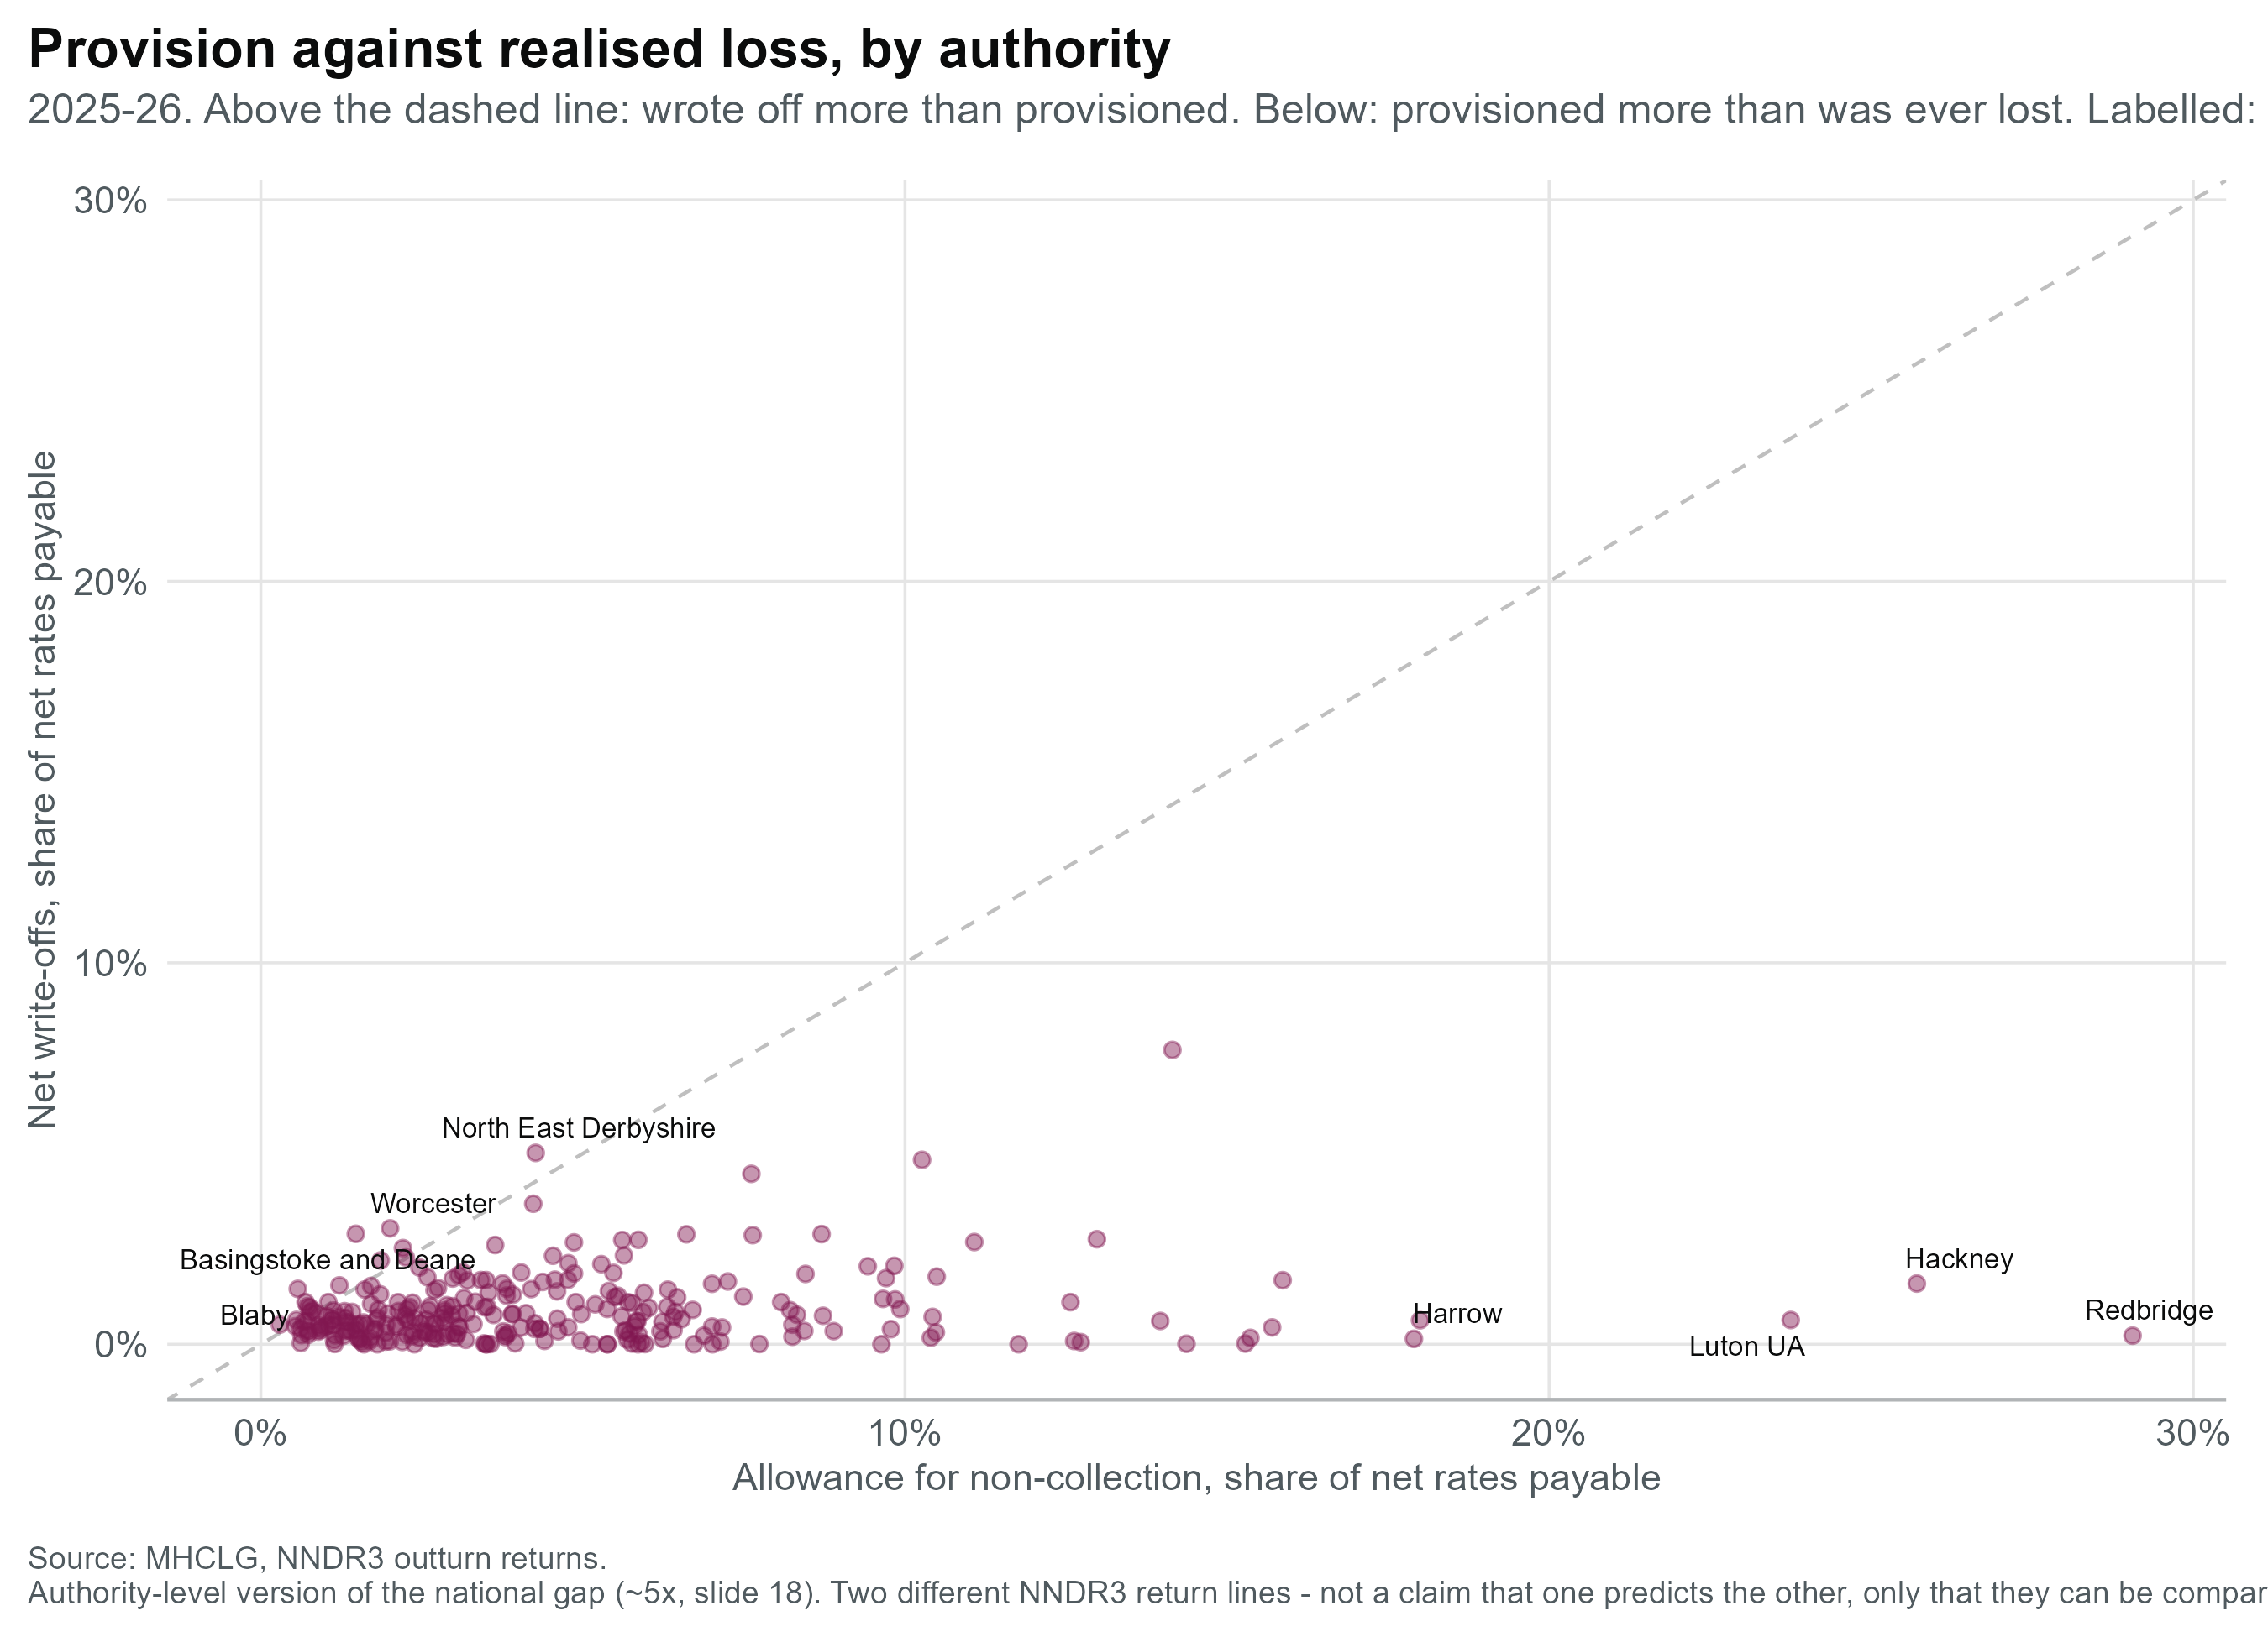
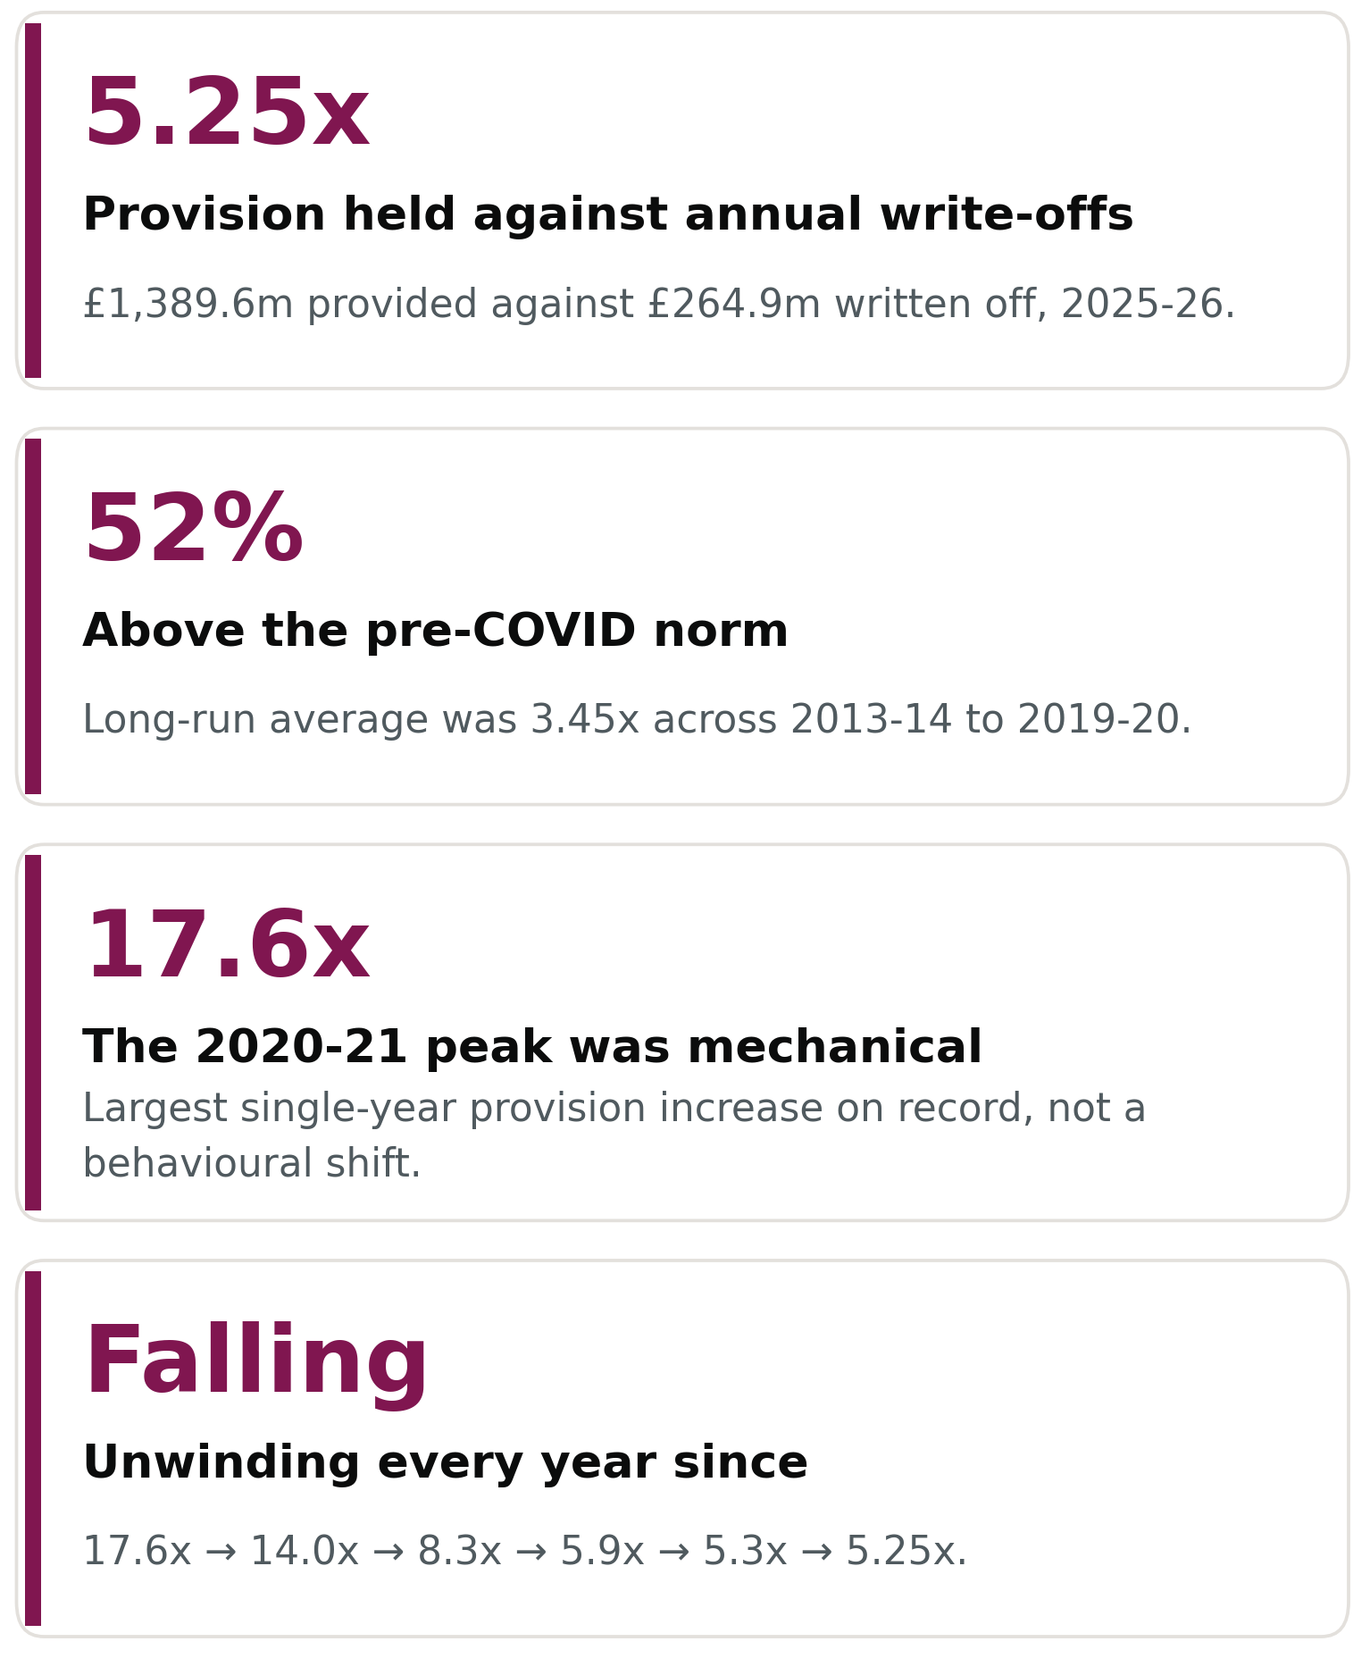
Authorities are holding provision several times larger than what is being written off annually
The gap between provision and realised loss is the forward-looking risk signal this metric was built to surface. Whether the current gap is expected for a stock-versus-flow comparison
Significance

Slide 22
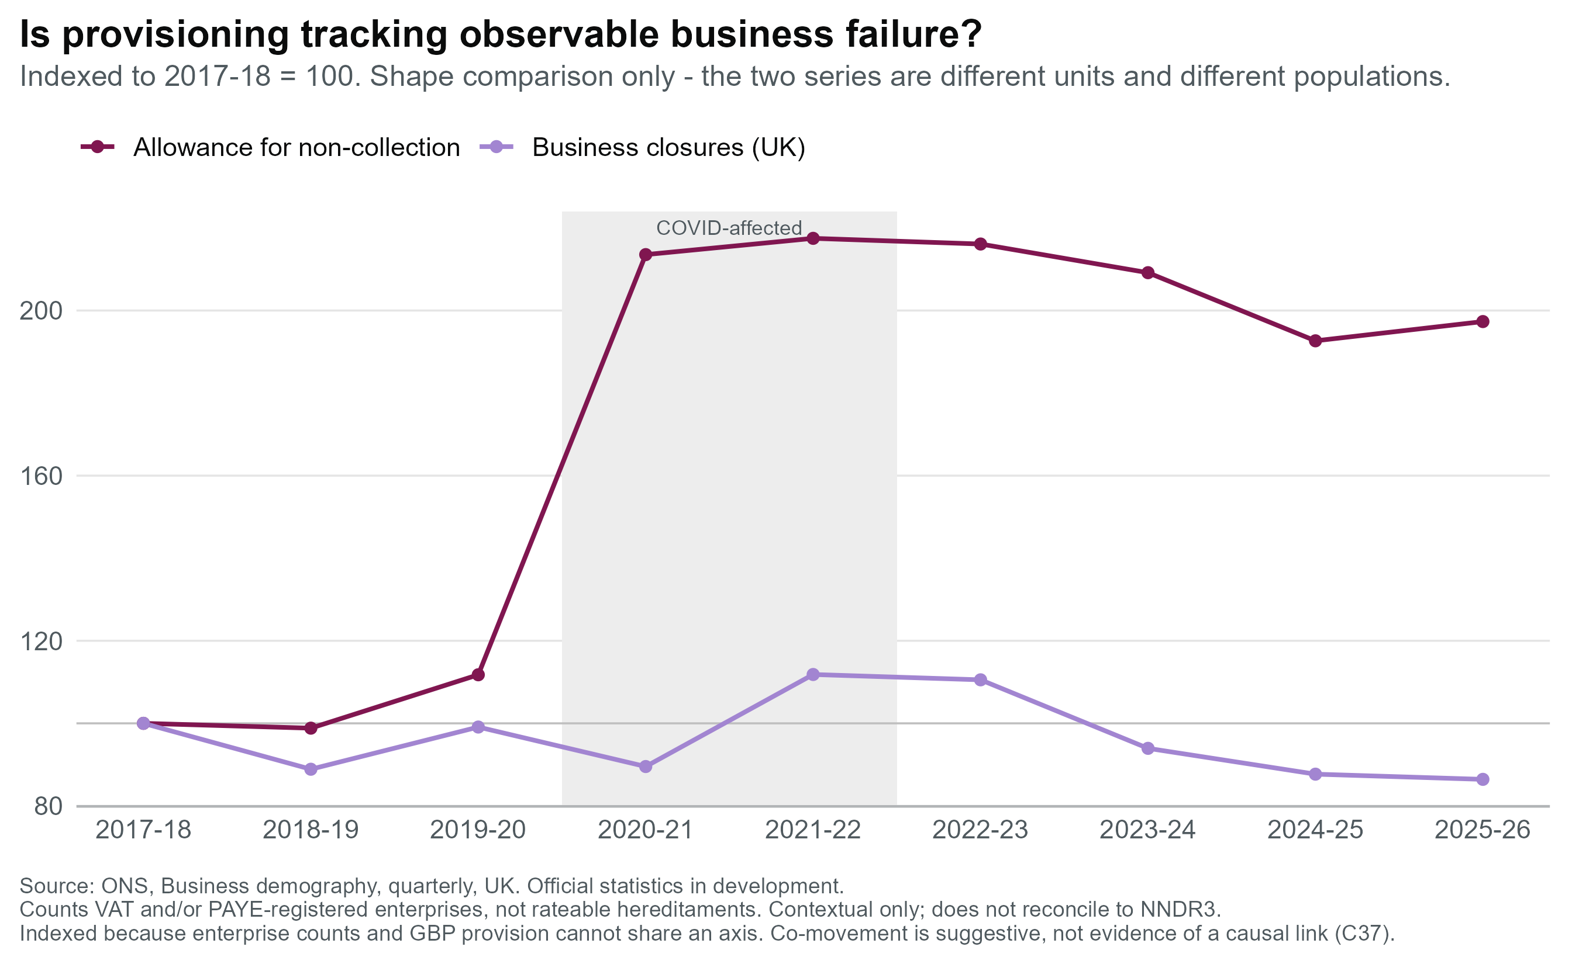
Is provisioning risk-responsive?
Allowance vs closure
Provision moved first. Allowance peaked 2020-21, a year before closures. Over £700m added in one year.
The loss arrived late. Write-offs troughed at £85.4m, now £264.9m. Provision ratio 17.6x → 5.25x, still 52% above the pre-COVID.
Pressure is concentrated, not general. Six authorities persistently top-quartile on all three metrics; Blackpool and Salford on every metric, every year. Post-industrial North and Midlands realise the loss; outer London provisions and accumulates without writing off.
Is the remaining gap an elevated risk view, or a write-off cycle still maturing? NNDR3 alone can't tell, it needs authority-level engagement.

Slide 23
End slide

